Slide 1






Developing E-assessments for Learning
AVETRA Practitioner Research Conference 2018
Selena Chan PhD

Slide 2

AIM: To IDENTIFY and DEVELOP e-assessment for learning activities.
Assessments for learning / E-assessments
Ako Aotearoa and NZQA funded project
- Rationale for project
Learning approaches framing the project
- Sub-project details
Developing e-assessments for my
own teaching

Slide 3

Assessments FOR learning
Formative
Provision of effective feedback to learners
Active involvement of students with their own learning
Allows the adjustment of teaching to account for assessment results
Contributes to motivation and engagement of learners
Builds capabilities with learners to allow them to assess themselves
Black & William, 1999
Students need to know the ‘response genre’, criteria for quality and extend ‘tacit knowledge’. Sadler, 2010

Slide 4




What are eassessments?
“the use of information technology in the design, delivery and administration of assessment activities, including the reporting, storing and transferring of assessment data.” – Stowell & Lamshed, 2011
Supportive of Learning approaches: learning as inquiry, problem solving, conversations, deliberate practice, reflection, ‘cognitive apprenticeship’, collaborative / team-based, learning as ‘becoming’
Examples of e-assessment for learning activities: projects, practicals, portfolios, discussions, assignments, tests, quizzes, presentations, reflections
Tools supporting e-assessments: apps, video annotation/note taking, AR / VR, learning analytics, social media

Slide 5




Majority of work has been:
School / Higher Education / ‘formal learning’ contexts
Assessments OF learning with challenges of authenticity, plagiarism, validity
Focused on building platforms for on-line exams
Privileging text-based literacies / cultures

Slide 6
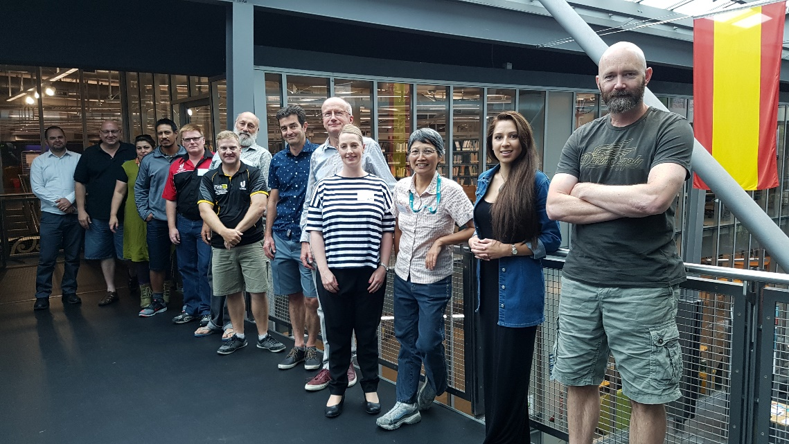
The project
Multiliteracies-based eassessments:
Guidelines for effective assessment for learning in level 2 – 5 programmes
https://akoaotearoa.ac.nz/Multiliteracies-based-e-assessments

Slide 7
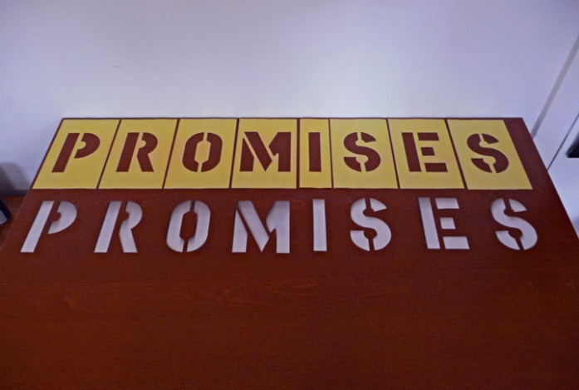
Record of learning
Ability to keep a progressive record
Capture authentic learning especially some of the socio-material
Multi-media – allowing for multi-literacies of learning to be articulated
Allows for just-in-time feedback – both inter- and intra-psychologically
Possibilities for ‘Learning as a Network (LaaN)’
Technology is not something external: it is the context in which learning takes place (Gros, B. 2016 p. 4)

Slide 8
WHAT are these??
Authentic learning as it applies to your own teaching context
Socio-material / socio-materiality as applied to learning (Fenwick – re-thinking the thing)
Multi-literacies as defined by the New London group
Inter / intra-psychological learning as with social development learning theories
Learning as a Network (LaaN) aka Networked Learning
WHICH of the above are most relevant to my teaching?
WHY are they relevant?

Slide 9

Based on the following
Better understanding of how ‘learning’ takes place
Importance of socio-cultural and socio-material contributions to learning
Acceptance of the need to celebrate cultural diversity
Access to ‘just-in-time’ feedback from ‘teachers’ through assessment for learning processes and availability of digital platforms to record and archive learning
Ability to capture learning as it takes place through the use of audio, video and/or screen recordings
Ubiquity of mobile devices and their improved capabilities
Increased access and decreased costs of mobile devises
Access to wifi and broadband

Slide 10

Potentials for e-assessments for learning
Learning becomes learner-centred, individual and social – Learning as a Network (LaaN)
Personalized and tailor-made learning opportunities – adaptive learning
Development of innovative pedagogical concepts to address, for example, experiential and immersive learning and social and cognitive processes
Ubiquitous learning – with some support from AI – artificial intelligence / smart agents
Leveraging off Learning analytics data for
both teaching and learning

Slide 11
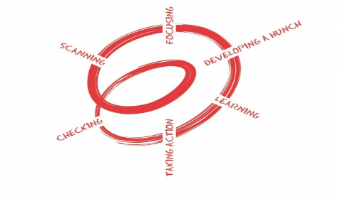
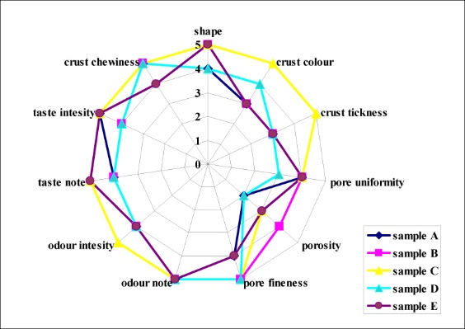

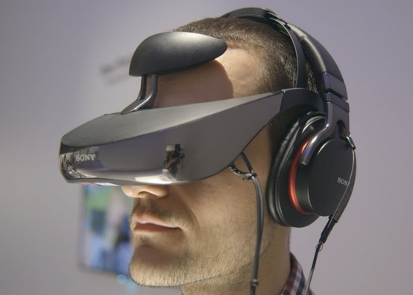

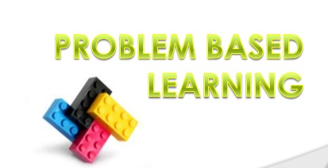
Sub-projects (participative action research – PAR)
Collating evidence during work-integrated learning (WIL) – learning through reflective practice
Role play/simulations to improve problem solving – inquiry and problem based projects
Learning to ‘taste like a chef’ – learning as multimodal, making learning visible, learning the language of the trade
Virtual welding teaching and learning platform – acclimating to requirements of multimodal learning, understanding learning analytics
VR 3D modelling platform for construction trades – learning spatial awareness, attitudinal transformation to be safe at work

Slide 12


Contact:-
Selena Chan
Learning Design, Academic Services Division
PO Box 540
Ara Institute of Canterbury
Email: Selena.Chan@ara.ac.nz
Blogging @ http://mportfolios.blogspot.com/

Slide 13
LEARNING as BECOMING
Doing
Being
Thinking
Feeling
Individuals’ construction of meaning
Constructivism
Contributions from others
Socio-cultural
Learning through using tools, machines, materials
Socio-material
Chan, S. 2013. Learning a trade: Becoming a trades person through apprenticeship. Wellington, NZ: Ako Aotearoa Southern Hub.
https://akoaotearoa.ac.nz/ako-hub/ako-aotearoa-southern-hub/resources/pages/learning-trade-becoming-trades-person-through-apprenticeship

Slide 14


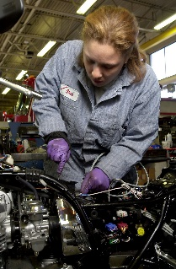

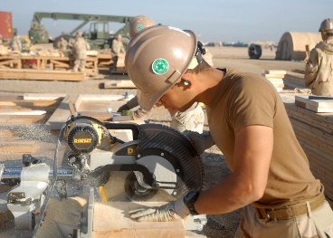

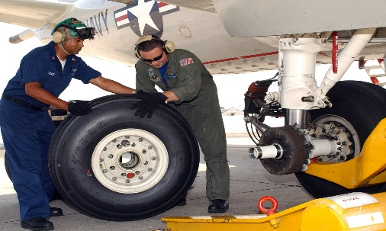
Assessments for learning and graduate profiles
Meeting graduate profile
LEARNING as BECOMING
Doing
Being
Thinking
Feeling
FEEDBACK
Summative Assessment
Formative Assessment (Assessment FOR learning)
Individuals’ construction of meaning
REFLECTIVE LEARNING
Contributions from others
COLLABORATIVE/ NETWORKED LEARNING
Learning with tools, machines, materials
NETWORKED LEARNING
BECOMING

Slide 15


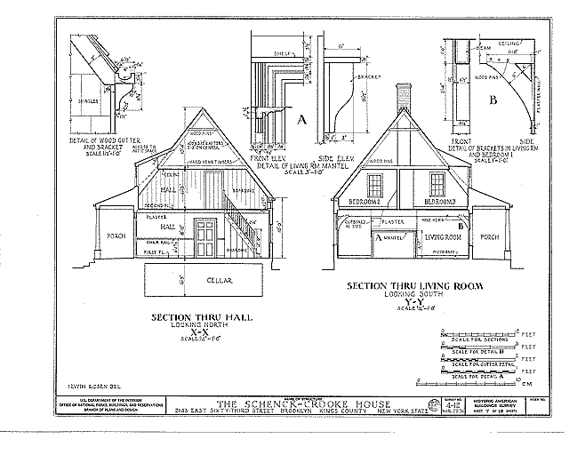
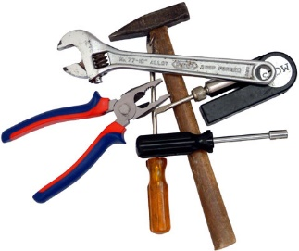

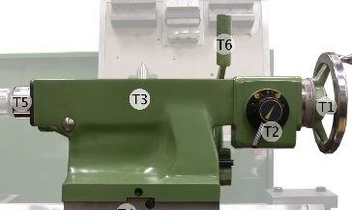
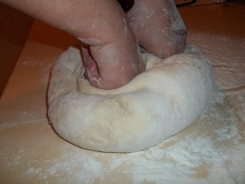

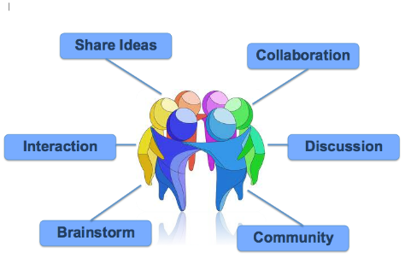
Learners
Access (knowledge, experts, peers, materials, data)
Deliberate practice
Reflective learning
Self-efficacy
Becoming
Learning analytics
Digital
Timeliness
Multimodalities and Multiliteracies Access (knowledge, experts, peers, data)
E-feedback
From SELF, OTHERS, MATERIALs
Learning
Collaborative
Multimodal
Holistic
Heutological – learner directed
Authentic / Situated
Learning centred
Evidence-based
Teaching
Teacher presence
Learner profile
Learning analytics
Administration

