Slide 1
A comparison of learning styles and success in classroom, work based and online learning
By Ann Murray

Slide 2
Introduction
There are three different study modes that Vocational Education and Training (VET) students can study in Australia
Classroom based
Work based
Online
While these may overlap, they tend to be distinctly separate
Each learning mode has its own advantages and disadvantages

Slide 3
Introduction
The aim of this study is to determine if the different modes of study are best suited to different learning styles
If this is the case it is envisaged that changes can be made to courses and how we teach them
The research aims to develop knowledge that can be used to help students to understand their own unique learning style in the context of VET.
This knowledge could be used by the students to help them to decide the best way for them to study

Slide 4
Definitions of learning styles
What is a learning style?
There is a general acceptance that different people choose to learn in different ways and that this way of learning has an impact on performance and achievement
The world of learning styles is very confusing with many different thoughts, ideas, theories and terms
Much of the confusing stems from the fact that people refer to learning styles with different names
There is not one single definition of what a learning style is and this where the confusion stems from

Slide 5
Definitions of learning styles
Coffield, Moseley, Hall and Ecclestone (2004) found seventy-one different learning style theories and placed them into five different categories:
Models that are based on learning preferences
Models that are based on learning styles (or cognitive styles as they phrase it)
Models that are based on stable personality type
Models that are based on learning styles that are flexibly stable learning preferences
Models that are based on learning approaches and strategies

Slide 6
Definitions of learning styles
Coffield et al (2004) have tried to illustrate which learning models are showing the traits that are more fixed and those that are more flexible and open to change.
Their research shows that there are many different models and theories within the learning styles field
Some of the confusion also stems from the fact that many learning style models cover more than just learning style, learning preference or learning strategy making them more difficult to place into just one group.

Slide 7
Why are learning styles important?
Learning styles are important, but they are not the only issue with learning.
Smith and Dalton (2005) tell us that a learner will have many characteristics and other things competing in their lives with their learning such as their:
Well-being
Aspirations
Motivations

Slide 8
Why are learning styles important?
Bostrom and Lassen (2006) ask if it is important for students to understand their own learning style so base their learning on this.
According to Bostrom and Lassen (2006) it is important to consider meta-cognition. This is the ability to think about how a person thinks
Using this reflection ability may promote lifelong learning and self-efficacy. It also gives learners and teachers a better understanding of how choices of learning strategies can affect learning in both a positive and negative way.
It enables students to empower and further their own learning
Students are able to learn better when they understand how they learn

Slide 9
Why are learning styles important?
Zapalska and Dabb (2002) used Fleming’s Visual, Auditory, Reading and Kinaesthetic (VARK) instrument to define the learning styles of two different section of business-economics courses in the United States, Poland and New Zealand.
They found that while there were differences in the ways the different nationalities learned they also found that the learning styles of the students covered all four learning styles.
Zapalska and Dabb (2002) suggested that teaching methods should be changed to accommodate the different learning styles
They also stated that it is important that students understand their own learning styles so that they know how they learn

Slide 10
Why are learning styles important?
Mokhtar, Majit and Foo (2008) also found that when students understood their own learning style they performed better
They divided the students into three different groups:
One group all had similar learning styles, were educated in their learning style and encouraged to use their learning style
The second group consisted of students with different learning styles who understood their learning style and were encouraged to use their learning style
The third group were not educated about their learning style and were not told what their learning style was

Slide 11
Why are learning styles important?
Buch and Bartley (2002) undertook a study in the workplace where they looked at the different ways learning could be delivered
That is in a classroom, computer-based, TV-based or audio-based
They found that people with different learning styles were more amenable to different modes of delivery
They also found that most people learned better in a classroom, but when that option was removed it was the person’s learning style that determined what mode of delivery suited them the best

Slide 12
Why are learning styles important?
As can be seen, by just these few examples in the literature being able to understand and use ones learning style will help the student understand how they learn and what they require to achieve a successful learning outcome
This will help the student with lifelong learning which is a central component of VET in Australia

Slide 13
The Onion Model
In 1983 Curry developed what she called her Onion Model
She developed it in response to the confusion surrounding learning styles
The Onion Model is based on empirically testable structures that encompass learning style concepts that have established psychometric standards

Slide 14
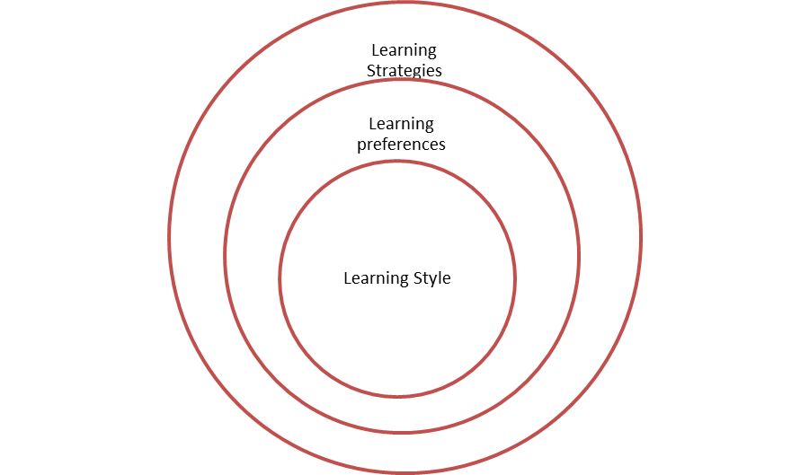
The Onion Model
The Onion Model has three layers

Slide 15
Learning styles in the VET sector in Australia
There has been very little work undertaken on learning styles in the VET sector in Australia
Smith and Dalton have published two papers concerning learning styles in the VET sector in Australia both of them in 2005
One paper looked at what learning styles were and how trainers in the VET sector could use learning styles
This points to the importance of learning styles in the VET sector in Australia

Slide 16
Learning styles in the VET sector in Australia
Basing their work on the Onion Model, Smith and Dalton (2005) use the following definitions:
Learning style – a distinctive and habitual manner of acquiring knowledge, skills or attitudes through study or experience
Learning preference – the favouring of one particular mode of teaching over another
Learning strategies – represent the plan of action adopted in the acquisition of knowledge, skills or attitude through study or experience

Slide 17
Learning styles in the VET sector in Australia
The research undertaken by Smith and Dalton (2005) has found the following about VET learners in Australia
They are more visual than verbal, in that they like to watch and see rather than read and listen
They are hands on learners who prefer to learn by doing and by practising
They are characterised by socially contextualised learning where they like to learn in groups with other learners
They are not self-directed learners, but like to have instructor guidance and a clear understanding of what is required of them

Slide 18
Learning styles in the VET sector in Australia
This is important as it shows us what the typical VET student in Australia is like, but does not take into account the many differences between people
The research that is being proposed will take into account the differences in how people learn and not to put them all into the same category

Slide 19
Learning styles in the VET sector in Australia
Smith and Dalton (2005) also undertook research in which they tried to identify the extent to which the VET sector took into account the different learning styles of students
They found that teachers in the VET sector were aware that students have different learning styles, but they tended to rely on personal experience to identify the students learning style, rather than having a test to determine what learning styles a student may have
It was also found that students have a very limited knowledge of their own learning styles and what this meant for them

Slide 20
Research into learning style tests
Coffield et al (2004) will be used as a guide to determine the which learning styles will be analysed
A decision will then be made on which learning style test to use for the purpose of this research
The work by Coffield et al (2004) will be used because it is the most comprehensive work undertaken on learning style tests
They reviewed seventy-one learning style tests and critically analysed thirteen major models

Slide 21
Conclusion of the Review of Literature
In conclusion the above can be summarised as follows:
Learning styles are important
There are a number of different theories concerning learning styles and the area surrounding learning styles is confusing in both the models and terms used
There has been very little work undertaken on individual students learning styles in the VET sector in Australia

Slide 22
Conclusion of the Review of Literature
For the purposes of this research the definitions of learning styles that will be used are taken from Smith and Dalton (2005)
Their definitions of learning styles are based on the model developed by Curry (1983) known as the Onion Model
These definitions have been chosen for two reasons:
Curry (1983) was the first person to try to consolidate the different definitions of learning styles. Many researchers now use this definition
Smith and Dalton (2005) have been the principle researchers in learning styles in VET in Australia and they have chosen Curry’s Onion Model (1983) as the standard definition of learning styles
Since this project is based on the learning styles of VET students in Australia it is appropriate to use the same definitions as previous literature

Slide 23
Methodology and Design
The gap in the literature formed two research questions
How can we use learning styles to help people decide the best way for them to study?
How can we use this information to help students to be more successful in their studies?

Slide 24
Methodology and Design
These questions will be answered using a case study
The type of case study chosen is a multi-case (embedded) design as proposed by Yin (2003)
Yin (2003) states that there are five components to a case study:
The research questions
Its propositions
Its unit(s) of analysis
A determination of how the data are linked to the propositions
Criteria to interpret the findings

Slide 25
Methodology and Design
Following Yin (2003) the proposition is that if a person understands their own learning style then they will be able to choose the best way for them to study;
Either online
In the workplace or
In a classroom setting

Slide 26
Methodology and Design
The unit of analysis will be the students
As there are twelve participants in the research this will be a multi-case study
It is also an embedded research because the research is exploring three different ways that a student can study
The following diagram adapted from Yin (2003) shows how this will work

Slide 27
Methodology and Design
Classroom
Workplace
Online

Slide 28
Methodology and Design
Four students in each study mode will be the unit of analysis therefore the research can look at each individual student, but also compare them across study modes
Yin (2003) states that multi-case study designs may be preferred over single-case study designs because conclusions that independently arise from more than one case will be more powerful than conclusions rising from only a single case
This allows for more rigour

Slide 29
Participants and data gathering
It is proposed there will be twelve participants in the case study
Four participants, each studying in one of the three modes of study;
In a classroom
In the workplace
Online
The students that will be used in this research will be studying from a Certificate III to a Diploma level
These certificate levels have been chosen as 55% of students are enrolled in these levels in VET studies (NCVER, 2007)

Slide 30
Participants and data gathering
A number of authors who have written books and papers on how to conduct case studies mention the importance of having more than one data collection method
This project will have four collection data methods:
The learning style test
Interviews with students, teachers and supervisors
Student diaries
Examination of students work

Slide 31
Participants and data gathering
Validity and reliability of the research is important
The four tests that need to be applied to ensure high quality results are as follows:
Construct validity
Internal validity
External validity
Reliability

Slide 32
Participants and data gathering Construct Validity
In a case study it is important to use multiple sources of evidence and to establish a chain of evidence
It is important that any researcher that comes afterwards is able to trace where the evidence came from
This can be done by properly documenting everything as it is collected

Slide 33
Participants and data gathering Internal Validity
Internal validity concerns how well the findings match reality
Yin (2003) states that there is a problem with internal validity every time something is inferred
Something needs to be inferred every time it is not directly observed
If the inference is wrong then the results will be wrong
Overcoming the problem of internal validity can be difficult in case studies. To help overcome the problem of internal validity in this research there will be interviews with students, teachers and supervisors and also the students documenting their own thoughts and feelings concerning their studies

Slide 34
Participants and data gathering External Validity
External validity is concerned with knowing that the case study findings are generalizable beyond the research
There are many critics to the case study method due to the small numbers involved, however Yin (2003) states that this is unwarranted
Yin (2003) explains that what a case study research is doing is relying on analytical generalization
In analytical generalization the researcher is attempting to generalize a particular set of results to a broader theory
Once this is done then the theory can be tested again and if the results are replicated over and over again then it can be applicable to the broader population

Slide 35
Analytical-Interpretive Framework
The following section concerns the data analysis of the project
There are three general strategies and five specific analytical techniques that can be used for the data analysis of a case study (Yin, 2003)
Not all of them are applicable to this research and only the ones that are applicable will be discussed

Slide 36
Analytical-Interpretive Framework
The first of the three general strategies is relying on theoretical propositions
The theoretical proposition in this case study is that if a student knows what their learning style is then they are able to better choose the best mode of study for themselves
The proposition can be used to guide the case study analysis and helps the researcher to focus on the important data and ignore other data
This is important because in a case study situation the researcher invariably ends up with a large amount of data

Slide 37
Analytical-Interpretive Framework
The second of the three general strategies is thinking about rival explanations
This means simply looking at other reasons that the results might be the way they are
This research will be looking at other reasons apart from learning styles that may determine why students are or are not successful in their studies
Yin (2003) says that the more rival explanations a researcher can address and reject the more confidence one can have in their results

Slide 38
Analytical-Interpretive Framework
The third general strategy is developing a case description. Yin (2003) says that this is only for a descriptive case study and as such is not concerned with this case study

Slide 39
Analytical-Interpretive Framework
The five specific analytical techniques mentioned by Yin (2003) are:
Pattern matching
Explanation building
Logic models
Cross-case synthesis
Time-series analysis
Only the first three of these are applicable to this case study

Slide 40
Analytical-Interpretive Framework Pattern matching
This is comparing an empirically based pattern with a predicted one
This is the most desirable technique for case study analysis
Patterns can be analysed across both the dependant and independent variables of the case study

Slide 41
Analytical-Interpretive Framework Explanation building
This is a type of pattern matching, but it is more complicated
The researcher is attempting to analyse the case study data by building an explanation about the case
The best explanation building attempts to explain causal links to an already existing theory
In this case it could be that a person’s learning style will have a bearing on how well they succeed in various study modes

Slide 42
Analytical-Interpretive Framework Logic models
The final technique that will be used is logic models at an individual level
This is a type of pattern matching, but with a difference
Logic models specially stipulate a chain of events over time and having a hypothetical intervention that changes this chain of events
For example, if someone is struggling with a particular study mode could changing that study mode to better suit their learning style have changed the outcome
In this way the researcher can also look at rival propositions as part of the logic model
For example, the researcher could look at what would have happened if the teacher had been different or if personal reasons had not affected their studies

