Slide 1
Operational Compliance within New Zealand Automotive Workshops
Niranjan Singh, nsingh@unitec.ac.nz
Unitec Institute of Technology New Zealand
Notes:
Use title slide layout

Slide 2
Paper overview:
My paper explains how data gathered by third year undergraduate automotive students, revealed weaknesses in compliance issues within automotive businesses but also raised their awareness of the Health and Safety issues.

Slide 3
Data collection method:
Over a two year period, four cohorts of students examined a range of workshops - focusing on how these businesses conducted their activities in accordance with relevant New Zealand legislation.
In total 109 students recorded their observations, undertook interviews and gathered visual evidence from 26 different businesses.

Slide 4
Selection of targeted data source:
Four types of automotive businesses were selected by the students:
20 general automotive service centers;
4 Paint and Panel beating workshops;
1 Tire replacement workshop, and
1 Warrant of Fitness Centre.

Slide 5
Relevant legislation under study:
Health and Safety Legislation: The Health and Safety Employment Act, (1992} and the Health and Safety at Work Act (2015),
Labour laws: Employment Relations Act (2000),
Environmental protection: The Waste Management Act (2008) and the Resource Management Act (1991).

Slide 6
Global Overview of Transport Industry:
Over the course of the next decade, the transport sector is expected to be a major force behind the growing world demand for the movement of people and goods, and,
the largest source of air pollution alongside industry (United Nations, 2006) and,
a profuse producer of greenhouse gasses that lead to climate change.

Slide 7
Service requirements:
As the sector grows, demand for vehicle servicing will therefore expand and this in turn will lead to the need for increased numbers of trained manpower.
However, the current lack of knowledge and disregard of legislation and regulation in the industry have degenerated into a degraded and disorganised support for the ever more important transport industry which can only be rectified through focused training and education.

Slide 8
Background to compliance incentives:
There are two basic incentives that encourage compliance:
There is the economic argument (Becker, 1968) which asserts that people obey the law once legal sanctions raise the expected costs of non-compliance beyond expected benefits - the 'stick approach'.
The legitimacy viewpoint, held mainly by sociologists and political scientists, that compliance is higher when people perceive laws to be legitimate and beneficial to them personally (Friedman, 2005) -the 'carrot approach'.

Slide 9
Health and Safety Compliance:
The following 2 cases demonstrate examples of compliance issues, related to the Employment Act (1992) which students found in 90% of the workshops visited.
In Case study 1, (under section 16) people who control workplaces have a simple duty to warn all visitors who have permission to be on their properties of any work-related, out­ of-the-ordinary hazards that they know about that may cause serious harm.

Slide 10
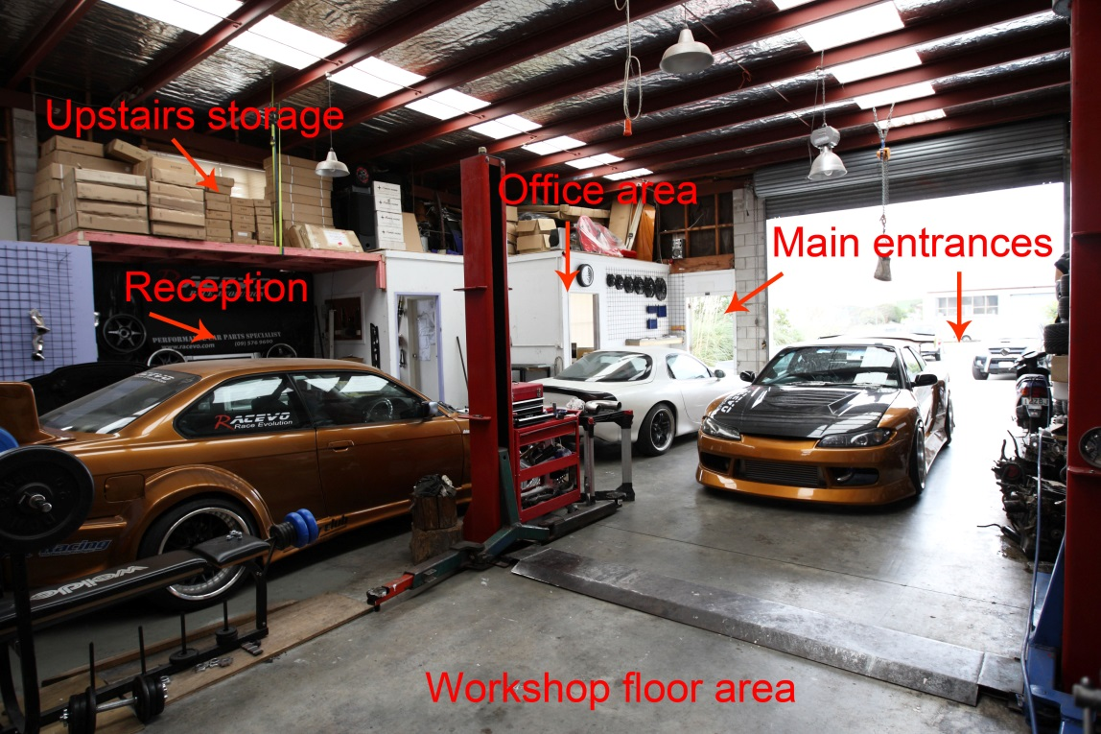
Case study 1

Slide 11
Evidence of non-compliance:
In the picture, the reception is located in the middle of the workshop. Customers or visitors can only access the reception through the main entrances. They have to walk across approximately half of the distance across the working area of the workshop floor area until they can get to the reception.
Due to this workshop layout, anybody can enter the workshop and any working area at will.
Students could not see evidence of any safety warnings.

Slide 12
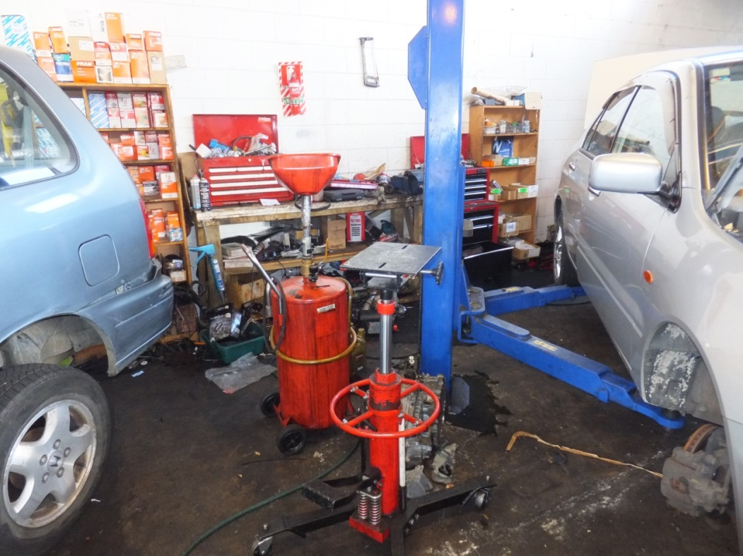
Case study 2

Slide 13
Case study 2 evidence
The students observed a systemic failure of the management to promote good practice and the failure of the workers to insist on a safe working environment. Examples of failures noted:
slippery floor with spills,
equipment placed in a haphazard and dangerous manner, and,
components on the floor which can cause workers to trip.

Slide 14
Case study 2 (continued)
Under the Fire Safety and Evacuation of Buildings Regulations (2006) students identified that the spillage constitutes a fire hazard and the disorganized equipment would hinder evacuation in case of a fire.

Slide 15
Empowerment of students
Many of the compliance failures observed can be correlated with two issues: ignorance of the legal requirements by workshop management and the socio-economic location of the business. (In SMEs Health and Safety may take second priority to business profitability)
As students identified these issues for themselves, they gained a greater level of awareness of the importance of several major aspects of H&S legislation.
This is likely to remain with them once they join the workforce.

Slide 16
Real world learning
Graduates improve industry practice
Students observe industry practice
Students report on industry compliance
Lecturer collates findings
Lecturer feedbacks to industry

Slide 17
Operational Compliance within New Zealand Automotive Workshops
Thank you.

