Slide 1
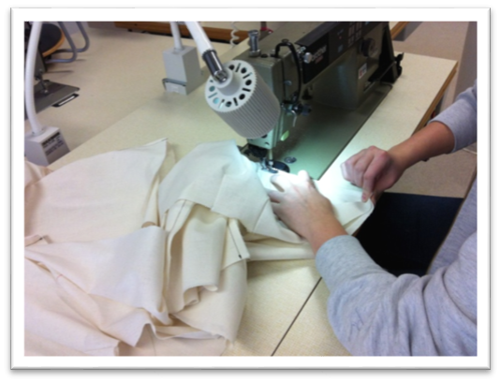
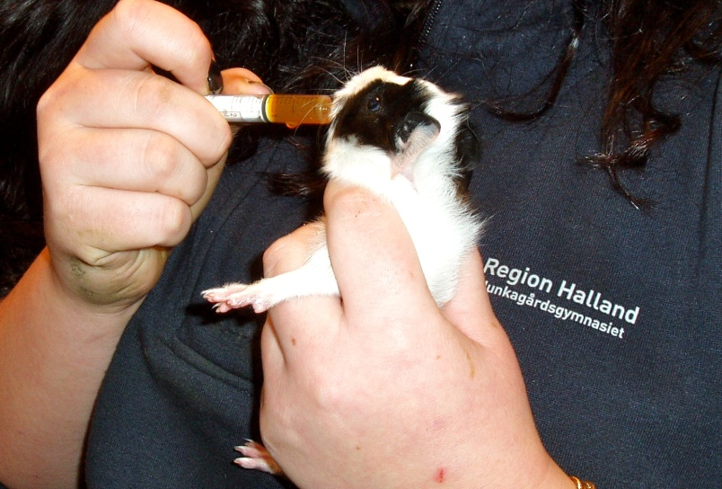
Enhancing VET quality. The risk of dumbing down the complexities of VET teaching and learning. The Swedish case.
Ingrid Henning Loeb, The University of Gothenburg
Paper presentation at AVETRA, Melbourne, April 8-10, 2015
ingrid.henning-loeb@ped.gu.se

Slide 2
For this paper, I have identified and analyzed what 96 VET teacher training students at the University of Gothenburg choose to investigate in an action research project during their final semester in their teacher training.
The analysis problematizes recent Swedish reforms with the intention of “enhancing VET quality”
the impact of a curriculum reform of VET 2011 in Sweden’s upper secondary school
the VET teacher education of 2011

Slide 3
Some information on VET in Sweden …
Upper secondary education
VET in adult education
3-year programs (16-19 year old students) since the early 1990s. Since the reform of 2011: 12 vocational programs (~30 %) 6 higher education preparatory programs (~57%) 5 introductory programs (13%)
VET in municipal adult education: Flexible programs corresponding to the levels and the curriculum in upper secondary school | Higher vocational education (Post-upper secondary education)

Slide 4
The three-year programs in Swedish upper secondary education

Slide 5
VET teacher education in Sweden since 2011
90 ECTS credits program: 60 credits of course-based studies 30 credits of work-based training (practicum) in upper secondary schools or adult education (full-time studies of one-and-a-half-year) Mostly distance-based studies with some on-campus meetings per semester. ~ 50 per cent of the students work as unqualified VET teachers in upper secondary education and in adult education.
Requirements to get admitted into VET teacher education: (1) a general university entrance requirement (based on completed high-school studies)
(2) specific competency-based requirements for vocational knowledge and skills in subjects matching the upper-secondary vocational subjects in different areas.

Slide 6
Swedish VET teacher education content:
The 60 ECTS studies of VET teacher education contain courses on general knowledge and skills that all teacher categories study, called “a joint core of educational science”.
The organisation of education and its conditions, foundations of democracy
Curriculum theory and didactics
Theory of science, research methods and statistics
Development and learning
Special needs education
Social relations, conflict management and leadership
Assessment and grading
Evaluation and development work

Slide 7
Some information on the context of the AR projects
The 96 AR projects were carried out during the last period of their studies at the University of Gothenburg (a practicum period equivalalent to 15 weeks full-time studies)
The AR project is estimated to be 25% of this practicum
Part of the previous course content has covered action research. Two tasks in that course are designed to develop knowledge and skills on how to work with an AR project
The students had some supervision when planning and designing their AR projects, and some supervision for analysis of the results
The projects were presented as Power points or Prezis, at the final campus meeting (15 minutes presentation, 10 minutes for questions)

Slide 8
The study: Thematic categories of the 96 AR questions
Category | Pedagogy, VET pedagogy and teaching methods | Standards, learning outcomes and assessment | Organizing | Student relations | Integration of different subjects in VET | Special needs educational issues
June 14 42 students | 15 | 12 | 4 | 4 | 5 | 2
Jan 15 18 students | 9 | 6 | 1 |  | 2
June 15 36 students | 23 | 9 | 2 |  | 1 | 1
Total 96 students | 47 | 27 | 7 | 4 | 8 | 3
 | 49% | 29% | 7% | 4% | 8% | 3%

Slide 9
Six themes/ categories | Examples of AR questions of the respective categories:
Pedagogy, VET pedagogy and teaching methods | How can we develop teaching and learning at school so it encourages and develops the student’s ability of documenting their workplace learning? In what ways can ”flipped classroom” methods be applied in order to promote deeper learning possibilities in the restaurant management classes?
Standards, learning outcomes and assessment | How can we visualize and clarify the link between specific tasks and the learning objectives? How can I clarify the intended learning goals for all my VET students, so each student is motivated to reach these goals?
Organizing | How can we create an overview of all tasks in different courses in an flexible adult learning program? How can we improve the involvement of students in the distribution of workplace learning and reduce our costs of administrating these workplace learning places?
Student relations | How can I improve relations among students in and between different groups? How can change the morning routines of my students so the come in time for class?
Special needs educational issues | How can I create a structured pattern of the school day, in order to help a student with neuro psychiatric needs in my class? How can I plan my classes so students with concentration problems better can reach the learning goals?
Integration of different subjects in VET | How can we enable a cooperation between the mandatory course in mathematics and the courses of hairdressing, in order to improve the student’s knowledge and skills in mathematics and mathematics for vocational purposes?

Slide 10
A closer look at the category “Pedagogy, VET pedagogy and teaching methods”
40 of the 47 students had questions addressing general pedagogic issues and general teaching methods.
7 students had questions specifically for their VET orientation
How can we change our teaching so that the students improve their knowledge of skills to redraft and alter patterns in clothing? (The Handicraft Program: orientation textiles)
How can we improve our teaching in order to develop the students’ understanding of measured feeding and meeting nutritional needs? (The Natural Resource Use Program: orientation horses)
How can we better combine the classes of theory and practice, so that the students get a solid understanding of the weight bearing beams, the parts attached to these beams and of wall supports? (The Building and Construction Program)

Slide 11
Why do so many choose topics of a more general VET character?
The course contents cover more general VET topics…
The university staff (like me) are generalists…
The length of the VET teacher education program (=1.5 years full-time studies) does not enable time to dig deeper into VET topics specific for the VET orientation …
Enhancing VET quality? Cf … if this was a math teacher education…

Slide 12
What is behind the 29% that are focusing on ”Standards, learning outcomes and assessment”?
The 2011 upper secondary reform with a new set of knowledge requirements, a detailed progression matrix and an extended grading scale.
Such issues predominate over issues of VET pedagogy and of the process how vocational knowledge and skills are developed by youngsters…

Slide 13
The Swedish case… same same but different?
The respective development of each VET teacher student (his/her development of pedagogical qualifications) is very dependent on the local VET practice where he/she teaches and/or do practicum.
It is questionable in what ways VET quality has been “enhanced” by the reforms…
The “practice architectures” of the respective VET site (including the interactional capacities by other qualified VET teachers and the partnerships in each site) constrain and enable what can be learnt and developed …
… by the VET teacher students and also…
… by the VET students

