Slide 1
An exploration of vocational pedagogy: types of knowledge used for teaching.
Adeline Yuen Sze, Goh. PhD
Universiti Brunei Darussalam

Slide 2
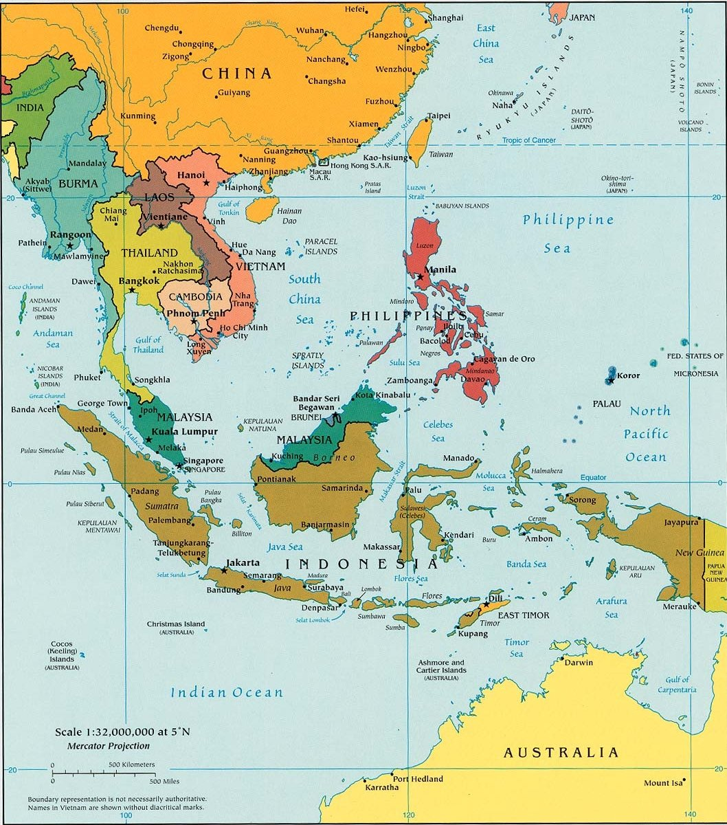
Map of Brunei
Notes:
Brunei Darussalam is an independent Malay Islamic Monarchy in South-East Asia situated on the North-Western coast of the island of Borneo. It occupies a relatively small land area of 5,765 square kilometres, in between the two large Malaysian states of Sabah and Sarawak. The capital of Brunei Darussalam is Bandar Seri Begawan, which is located in the Brunei-Muara district.
The country’s population is approximately 400,000 where it a large percentage of the population is Malays, and the remaining consists of chinese, indigenous groups and foreign workers.

Slide 3
Overview
Vocational Pedagogy and Vocational Knowledge
Knowledge Base of Vocational Education Teachers
Brunei Context
  Vocational and Technical Education in Brunei
Findings from the study
Discussion

Slide 4
Vocational Pedagogy/education – starting point
Vocational pedagogy is marked by a country’s historical and cultural formation usually leads to a broader or narrower understanding of vocational education and training (Avis, 2014)
Vocational education relates to the groups of occupations.
Vocational pedagogy links subjects and jobs (Barnett, 2006)
The reference point for vocational teaching is
industry currency

Slide 5
Vocational Pedagogy
Basic issues of vocational pedagogy.
The overall process of vocational learning and teaching, which includes vocational pedagogy and the content is influenced by workplace activities, and disciplinary knowledge.
Disciplinary knowledge <-> Vocational pedagogy
Recontextualised disciplinary knowledge or knowledges selected for vocational pedagogy (Barnett, 2006)

Slide 6
What knowledge base?
Schulman (1987) - content knowledge; general pedagogical knowledge; curriculum knowledge; pedagogical content knowledge; knowledge of learners and their characteristics; knowledge of educational contexts i.e. ranging from the working of the group or classroom.; knowledge of educational ends.
Turner-Bisset (2001) – 12 knowledge base including knowledge/models of teaching; knowledge of self and beliefs about subject knowledge.
Verloop, Van Driel and Meijer (2001) : subject matter, students, student learning and comprehension, purposes, curriculum and instructional techniques.

Slide 7
What knowledge base must vocational teachers be equipped with?
Chappell (1995) – teacher’s knowledge base of vocational education differs from those teaching in school sector of education.
Loo (2008) – teacher knowledge in the post-compulsory sector in the UK ; he argues that employment experiences together with life experiences are required for teaching in this sector.
Robertson (2008) – proposed that professional VET teachers require a full complement of teachers’ knowledge bases in order to be able to practice in a diversity of environments.

Slide 8
“When we come to consider teachers’ professional knowledge, we find that they are in a unique position. Unlike engineers, lawyers or nurses, for example, who all acquire specialist knowledge that is directly related to their field of practice, most teachers in post-compulsory education are faced with first acquiring specialist knowledge of their chosen subject, and then the knowledge of how to teach it. This duality is most marked amongst teachers in the post-school phase.”
Robson (2006 p 14)

Slide 9
Vocational and Technical Education in Brunei
Vision and Mission
Seven Vocational and Technical Education institutions.
Transformation
Vocational Teachers in Brunei
Recruitment of vocational teachers;
Vocational Teachers’ teaching practices
Competency- Based Training

Slide 10
The study
The aim of the study is to investigate the types of knowledge vocational teachers draw on to teach.
It is a small-scale study focusing on a group of vocational teachers who have undergone a one year teacher training programme.
These vocational teachers have a varied background though not representative of the whole VTE teaching cohort, they have varied backgrounds in terms of their work experience abroad and their teaching experiences.

Slide 11
‘Need to understand how it works in the industry’
‘ I have just finished teaching event management. Before I taught this, I had to understand the industry, how it really works, how the operation of the event works. So what was the daily operation of events in the industry, from meetings, writing proposals, getting the idea and themes, and once that is completed, and really plan it out on the logistics and how things should happen before actual execution of the event. So having an understanding of the industry itself, you are able to compartmentalize and I think with my classes, various mediums were used, videos, so that the students can really understand that the process…’
Mona, worked in industry before, taught for 4 years

Slide 12
‘Using real-life working examples’
‘Teaching theoretical units is a challenge if you don’t incorporate real –life examples. When it comes to teaching theoretical units, I find that students are able to learn better if they were to experienced it themselves, incorporating that to the teaching methods, where students get to discover components of certain units, they understand better…’
‘With having worked in the industry before, I can pinpoint which of the topics in the programme guideline is really important for my students to know and which one is not so important’
Kate, worked in industry, 4 years of teaching experience

Slide 13
‘it’s not just teaching how to be a tour guide, it is about knowing how to be one’
‘…must experience the industry of the discipline itself in order to be better relate to the students of what they will face in the future. As an individual working in the real-world you will face loads of challenges. It’s all multi-levelled problems that you face, the work operations. I have never taught this new module. I now how to teach the different elements of tour guiding but to actually do it, like explain the flora and fauna in Brunei, I will need to physically go in the jungle, learn from a real botanist. I don’t need to go in depth but I want to do it…so for source of knowledge, I must to the actual source (real-world work situation) where they are specialist of that, and learn from their best practices.’
Mona

Slide 14
Methods of teaching
‘It was a good thing that I did my teacher training programme because …I tried to incorporate into my lessons what we have learnt in the programme and it really helped.’
‘When I started teaching, it was a struggle for me as I was given the programme guideline and they expect you to start teaching. Personally I have to study myself for all the topics in the programme guide. Only certain topics I have learnt before so they are familiar to me…I think with how I plan my lesson I keep in mind the activities that I should involve the students, which is one of the most of the difficult parts of the lesson planning…’
Leah, No working experience

Slide 15
Pedagogical knowledge
Clearly identified pedagogical knowledge as important.
Leah had no work experience or work knowledge to draw upon. She had to re-learn before she could teach the subject.
She had double challenges as she had to learn the subject and learn how to teach the subject.

Slide 16
Past experiences: Work related knowledge
Past experiences were important when designing learning activities;
More specifically, workplace knowledge used in explanations in lessons;
Relate their subject matter knowledge to workplace knowledge.

Slide 17
Vocational Teacher’s knowledge
workplace knowledge is seen as important component by vocational teachers in designing their lessons.
Vocational Teachers’ knowledge base should include vocational disciplinary knowledge and specialized vocational pedagogy (Corbel et al, 2014).
‘Knowing how’ appears to be more of a significance than ‘knowing that’

Slide 18
Next stage
With this preliminary finding, a larger scale research study is proposed to help conceptualise the knowledge base needed by vocational teachers in Brunei during this reform from an outcome based training to competency-based training.

Slide 19
References
Avis, J. (2014) Workplace learning, VET and vocational pedagogy: the transformation of practice, Research in Post-compulsory education, 19(1), 45-53.
Barnett, M. (2006) Vocational knowledge and vocational pedagogy in M.Young and J. Gamble (Eds) Knowledge, Curriculum and Qualifications for South African Further Education, South Africe: HSRC Press.
Loo, S. (2008) Teaching knowledge, work-based learning and life experiences, Paper presented at the British Educational Research Association Annual Conference, Heriot-Watt University, Edinburgh, 3-6th Sept, 2008.
Robertson, I. (2008) VET Teachers’ knowledge and Expertise, International Journal of Training Research, 6(1), 1-22.
Robson, J. (2006) Teacher Professionalism in further and higher education: Challenges to culture and practice, London: Routledge.
Shulman, L (1987) Knowledge and teaching: Foundations of the new reform. Harvard Educational Review, 57, 1-22.
Turner-Bissett, R. (1999) The knowledge bases of the expert teacher. British educational research journal, 25, 39-55.
Verloop, N., Van Driel, J. and Meijer, P. (2001) Teacher knowledge and the knowledge base of teaching, International Journal of Educational Research, 35(5), 441-461.

Slide 20
Thank You
Email: adeline.goh@ubd.edu.bn

