Slide 1
From Fleming to Productivity Commission
Is VET teacher preparation walking the tightrope?
Roger Harris
Adjunct Professor
University of South Australia

Slide 2

Presentation Outline
1. Introduction
2. Fleming Report (1978/79)
3. Productivity Commission Report (2011)
4. Between these reports
5. Concluding thoughts …

Slide 3
1. Introduction: two starting points
1. Hermann, Richardson & Woodburne (1972), Trade and technician
education: principles and issues (Ch. 7 on teachers)
What institutional setting is best for T/E programs?
What academic awards shd. be given on completion of the T/E course?
“Providing a T/E course for teachers of trade and technician courses that will produce competent practitioners as well as producing teachers with a broad outlook has not proved easy, nor are there likely to be simple solutions to the problems that such courses raise.” (p.117)
“The initial T/E courses … are only a starting point to professional development … if teachers are improve their teaching competence, maintain an up-to-date knowledge of their trade or technician field, … they must have the opportunity to take part in readily available, comprehensive & systematic programmes of in-service devt.” (p.118)
2. A personal odyssey!
Lifelong education; Tough; Knowles; Kangan … Awakening!
Notes:
I want to start with 2 introductory points …
These are prophetic words, in 1972 – we have been struggling to solve these dilemmas ever since! That is the key thread through this presentation.
This presentation will show what I mean.
2. Personal odyssey
Lifelong education: work of the UNESCO Institute for Education, Hamburg in early 70s:
1976: RH Dave, Foundations of lifelong education
1977: AJ Cropley & RH Dave, Lifelong education and the training of teachers
Allen Tough:
1971: The adult's learning projects: A fresh approach to theory and practice in adult learning Until the end of the 1970s, Tough's line of research focused on the adult's successful efforts to learn and change, particularly the 70% of adults who are self-guided without relying much on professionals or institutions.
Malcolm Shepherd Knowles:
1973: The adult learner: A neglected species
1975: Self-directed learning: A guide for learners and teachers
1980: The modern practice of adult education: From pedagogy to andragogy
Kangan Report (1974):
Formalised what we know as TAFE; created a vision, a new paradigm in thinking; etc.
I started in TAFE T/E at the beginning of 1975 – been my career ever since …!

Slide 4
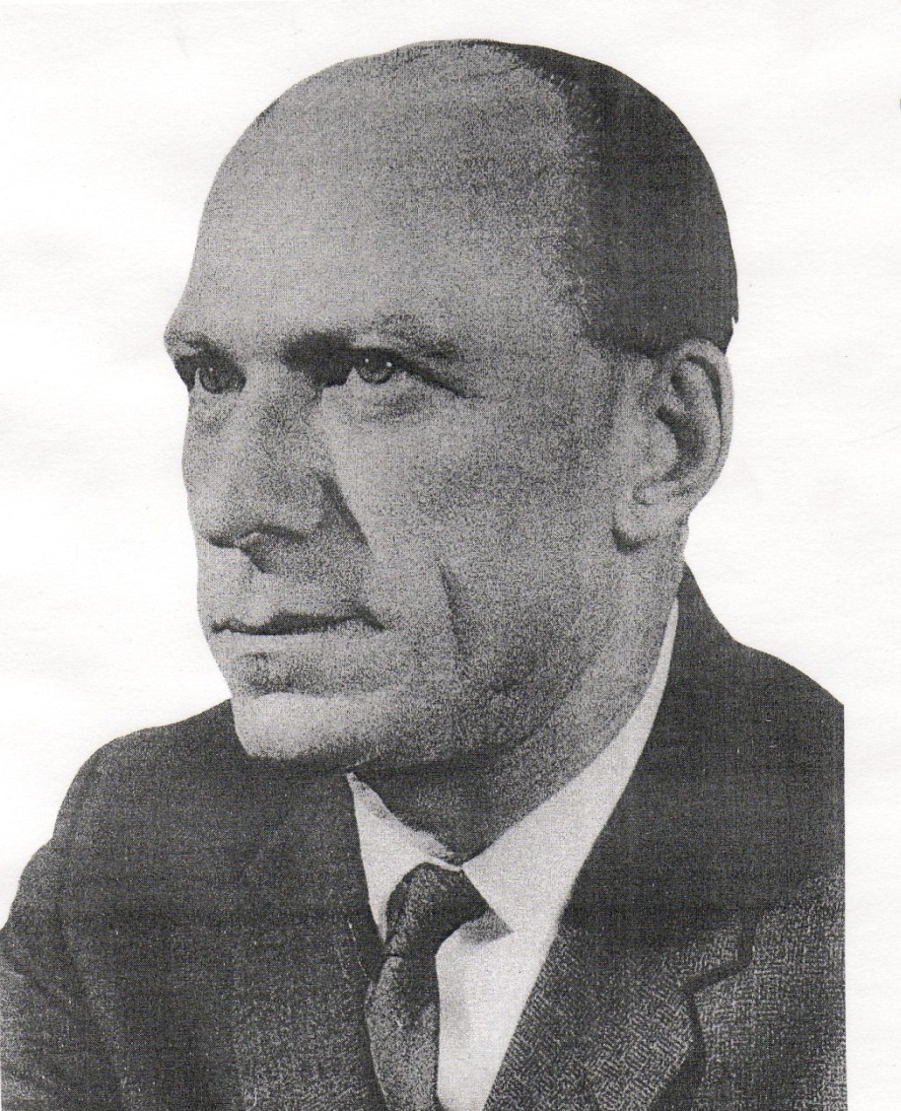
Myer Kangan
OBE (1972), AO (1983)
1917 - 1991
Lifetime of govt. and community service
Australian Committee on Technical and Further Education (ACOTAFE) report 1974
Notes:
Australian Committee on Technical and Further Education (ACOTAFE) represents
only a small part of a remarkable career, the work of the committee under his
direction, changed the face of technical education in this country.
In his own words, the ACOTAFE report:
gave TAFE a new image
gave TAFE a new status among other education authorities
gave TAFE a clear definition as to its charter and possible philosophy
began a process of student-centred, individual-oriented vocational education which severely wounded (but nor mortally, he regretted) the notion that TAFE is the passive servant of industry and commerce
ensured for all time, he hoped the primacy of TAFE colleges as educational institutions in contrast to mere training centres.
[From Gillian Goozee chapter]

Slide 5
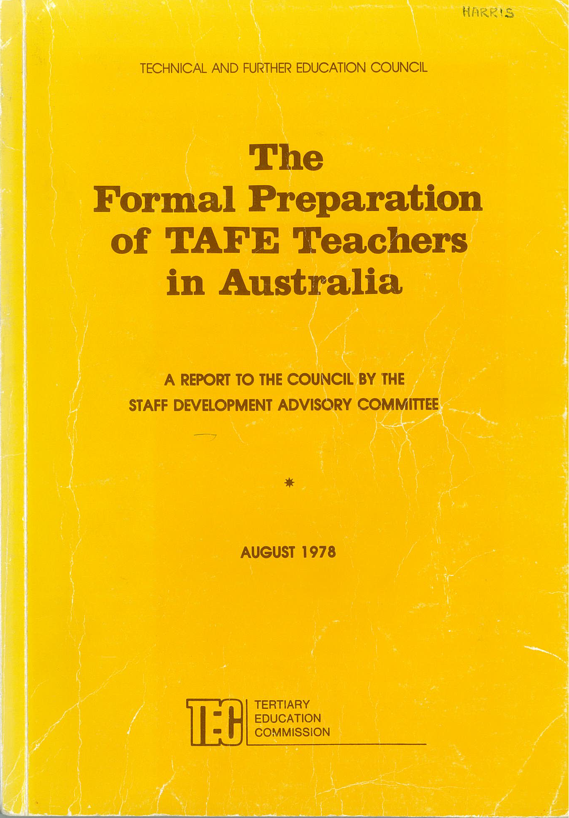
Notes:
I turned to the Fleming Report of 1978 – to examine what were the issues for what was then TAFE T/E at that time – to ‘piggy-back’ on Hermann’s prophetic words 1972!
The Kangan Report had recommended a special inquiry into the formal preparation of TAFE teachers.
The TAFE Council then commissioned its Staff Development Committee to gather additional information to assist the Commonwealth Government in developing robust future funding policies for TAFE teacher education.
Methods:
Study visits to each State – to discuss issues with stakeholders
Survey of fulltime TAFE teachers (59% response rate – high) – to obtain a basic database [data on VET workforce hasn’t improved at all since!]
UK expert – Eric Twigg (Huddlesfield) - visit each program to undertake a detailed analysis of curricula
The 1978 report was circulated as widely as possible for discussion – and a slightly amended shorter report focused on the recommendations was finalised by the TAFE SD Committee a year later in August 1979 (under shared chairmanship of Keith Coughlin and Stewart Houston – Fleming was ill and had to retire from the TAFE Council). COUGHLIN REPORT
Purpose? It strongly endorsed the initial Fleming Report (1978)
Significance? Committee was ‘as convinced as its predecessor that greater attention must be paid to this field of teacher education if it is to meet adequately the teaching staff development needs of a sector of Australian education on which increasing demands are being made.’

Slide 6
Key points in these reports
All TAFE teachers to undertake a ‘nationally accredited award at advanced education level’, capable of being completed within 3 years (UG2) – release
Reinforced the model program (Fleming) of 3 elements – no liberal studies or technical studies
‘Each participating institution should accept that TAFE T/E has a high priority in its operations’
TAFE and CAEs to increase scope and effectiveness of joint arrangements
Courses to be based on objective assessment of functions of all categories of TAFE teachers and the K and S necessary …
Moves to expand number of institutions ‘must be resisted to prevent dissipation of resources’ - number kept to a minimum
Improve student/staff ratios in TAFE T/E; and build library resources
Desire for all teachers to be in same program (i.e. against PG1)
Commended Adv. Ed. Council for its special grants in 1979 for initiatives in TAFE T/E - wanted continuance in 1980
Rec 11: a Working Party between providers – leading to ‘a full-scale national conference in second half of 1980’
Notes:
1st point – i.e. a respectable award, requiring adequate release by State Govts.
2nd point – 3 elements: an induction course of at least 2 weeks; a program to meet beginning teachers’ immediate needs; and a program providing “wider and deeper studies of educational and societal issues” (e.g. history of technology; impact of technological change; origins and effects of unemployment in industrialised societies, application of ergonometric techniques which apply to a wide range of vocations), and including electives introducing specialist functions of TAFE such as external studies and education of minorities.)
3rd point: “each participating instn. should accept that TAFE T/E has a high priority in its operations. It should therefore seek to develop a focus of expertise in TAFE teaching and the teaching of adults. This focus should be reflected in appropriate numbers of staff specialising in adult T/E and in the devt. of admin’ve. structures which reflect the priority for TAFE T/E within the instn. …”!
More career TAFE teacher educators needed to be recruited or developed
5th point: forerunner of C-B approaches? E.g. TAA?
6th point: more later)!

Slide 7
2. Fleming Report (1978/79)
The formal preparation of TAFE teachers in Australia
In my view, the Report was:
- a catalyst for a much-needed boost to VET teacher
education - to that time piecemeal and variable
- first systemic effort at improving the quality and
standing of VET teachers
- conduit for considerable funding allocated to resources,
particularly for pedagogy aligned more to the needs of
VET teachers than school teachers
Notes:
Major contributions – in my view … [SLIDE]
NOTE:
Keen to ensure award for TAFE teachers was a respectable qual. at AE level
All beginning teachers to do it
State and C/W govts. to bear the cost
TAFE T/E was a joint responsibility between TAFE and CAEs
Number of providers to be kept to a minimum
Concerted move away from preparation in-house

Slide 8
Institution | UG3 | UG2 | PG1 | Others
Mt Gravatt CAE (Qld) |  | Dip in T (TAFE) 100
Newcastle CAE (NSW) (prev. STC) |  | Dip in T (TAFE) 108 | Dip Ed (TAFE) 10
Sydney Teachers’ College (NSW) |  | Dip T (Tech) 576 | Grad Dip in Ed (Tech) 132 | Conversion to Dip 155
Hawthorn SCV (Vic) |  |  | Grad Dip Ed 250 | Ed. Dept: T’d T Trs Cert 22 2 others 204
Torrens CAE (SA) | A/Dip FE 42 | Dip T (TAFE) Int 277, Ext 111 | Grad Dip FE 29 | B Ed (In-service) 40
Canberra CAE seeking 1978, (prev. STC) | A/Dip T (TAFE) 28 |  |  | BA (TAFE)
Centre for Cont Ed of Teachers (Tas) | Ed Dept: Technical Instructors Certificate (3 yrs PT) - validated by Tas. CAE, not yet accredited 70
Technical Extens’n Service (WA) | Ed Dept: Teacher’s Certificate (Technical) metro 140, c’try 10 Diploma for Technical Teachers 99
Notes:
This was the TAFE T/E situation in 1978 (as far as I can compute out of the Fleming Report appendices)
- Hawthorn – the TTTC soon (by 1980) became a Dip Tech Tchg (UG2)
other 2 were: Trained Technician Instructor’s Cert 14;
Trained Trade Instructor’s Cert 190
- Canberra – not specified which award
- WA - in 1980, WA Dept. was negotiating with WAIT (later Curtin) to
provide programs
Total enrolments – around 2,403
1,857 at Adv. Ed. level [ie: about same HE number as
Guthrie’s number in univs in 2008]
546 in State Ed. Depts. (gradually moving to CAEs)
NOTE:
External Studies at Torrens CAE
I developed the PG1 at Torrens CAE – 29 was first year; numbers were to rise in the program to well over 100

Slide 9
3. Productivity Commission Report (2011)
TAA certificate, when well taught, represents a satisfactory minimum standard for trainers & assessors
TAA does not always equip teachers with skills required to deliver VET effectively
TAE10 TP doesn’t completely cover diversity of roles in VET, nor fulfil its potential as a basis for PD. Innovation and Business Skills Australia to remedy these gaps
Concerns about quality of delivery of Cert IV long‑standing, persistent & supported by recent audit evidence
Clear options and pathways for study beyond Cert IV (TAA) should be available to the sector, but higher‑level qualifications should not be mandated
Recommended improvements in workforce data
Concluded its reforms would ‘make the VET workforce … more flexible, more adaptable and more capable’
Notes:
Opportunities for PD beyond the Certificate IV (TAA) are not adequate. Governments need to collaborate to identify what effective PD requires, then assess the adequacy of their funding provisions. RTOs need to assess capability gaps within their workforces, and target resources accordingly.

Slide 10
So both reports: 1978 and 2011 …
Placed their focus almost exclusively on initial teacher preparation
Reported concerns that what existed was not adequate, or of quality
Vigorously debated the most appropriate award – opted for a particular minimum qualification
Were vague about the notion of PD / career pathways
Lamented the lack of data, calling for improvements
Were optimistic that their recommendations would lead to better outcomes!
Notes:
PD / Pathways – treated anything beyond the initial preparation as a too hard basket.
Explicitly acknowledged in the Second report (1979) that had stated: “… some studies presently included in some preparatory programs shd. appropriately be considered part of the continuing PD of TAFE teachers” – but did not elaborate further.

Slide 11
4. Between these reports
Training market was opened, including teacher preparation – introduction of the Cert IV 1994
Great expansion in number of providers of VET T/E
(cf. 1978/79 strong recs. that numbers be restricted):
- in 1978: 5-6 CAEs and 2 State Depts. (WA and Tas)
(approx. 1,857 AE students - Fleming Report)
- by 2008: 20 active universities
(approx. 1,984 HE students - Guthrie)
plus
- by 2015: 808 with Cert IV on scope (2011: 39, 295)
134 with Dip VET on scope (2011: 1,491)
114 with Dip T&D on scope
Notes:
What has happened between these two landmark reports is obviously too extensive to deal with adequately in a short presentation!
I have therefore chosen to draw attention to some of the lesser known sources – that possibly don’t appear anywhere else except on personal bookshelves (like mine)!

Slide 12
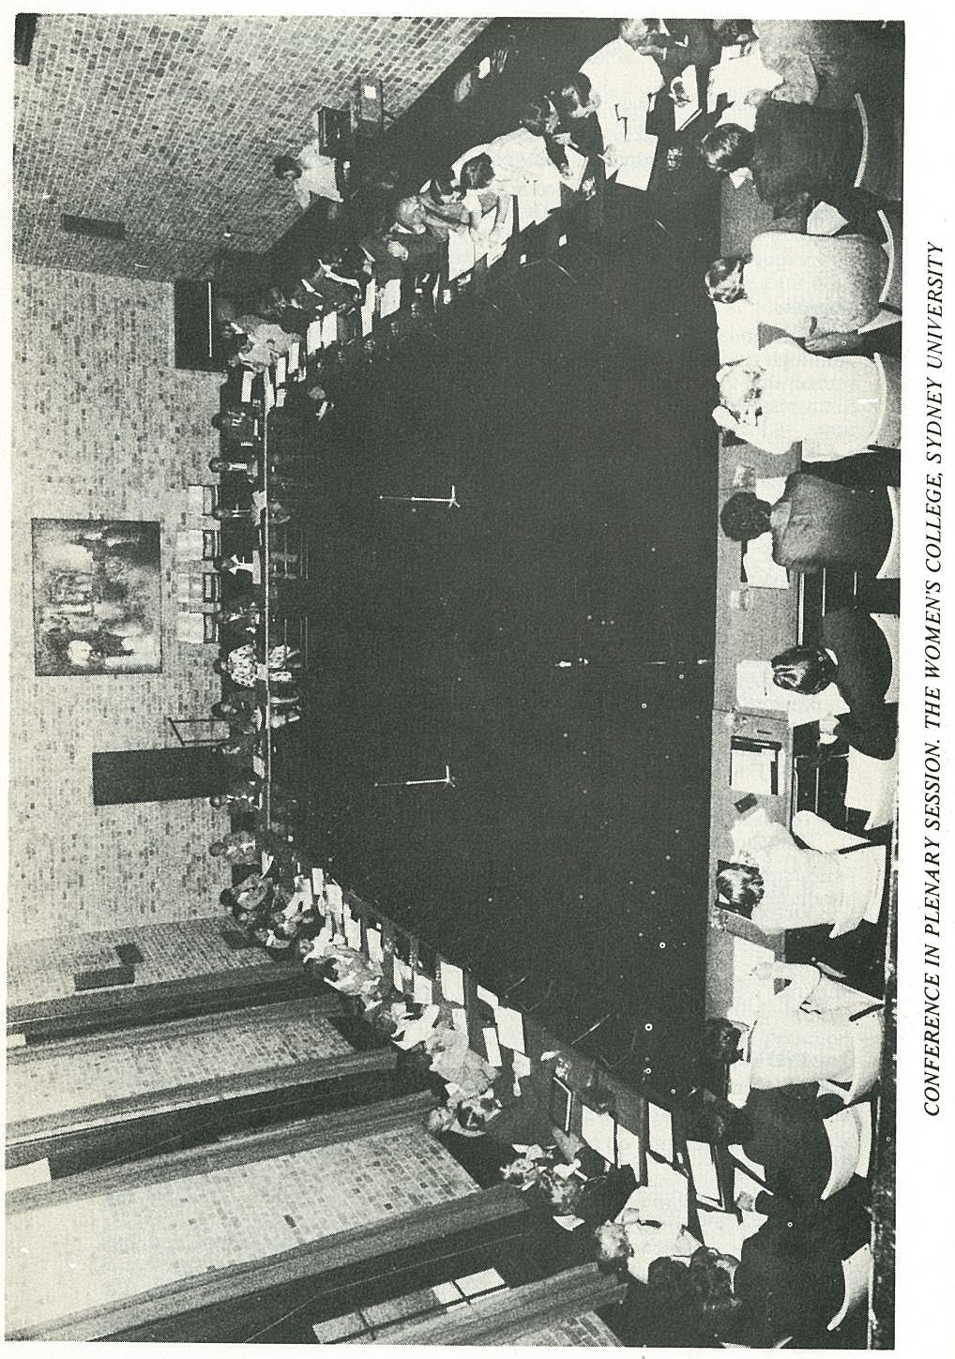
Notes:
Here we are!
1st National Conference of teacher educators for TAFE – as recommended in the 1979 Report, and funded by the C/W (TEC)
Women’s College, Sydney University
10-13 August 1980
N=62
Wide representation:
CAEs (Hawthorn Inst. of Ed., Sydney Teachers’ College, Adelaide College of the Arts & Ed., Newcastle CAE, Darwin Community College, WAIT, Mt. Gravatt CAE, Tasmanian CAE)
TAFE Departments (Qld, WA, SA, Vic, NSW, Tas)
TAFEC (incl. Peter Fleming, John Grant)
TAFE colleges (Gordon, Yeronga, Adelaide, Fremantle, Bruce, Meadowbank, Hobart, Canberra)
Tertiary Ed. Commission - ACT (3)
TAFETAA (Union, Sydney)

Slide 13
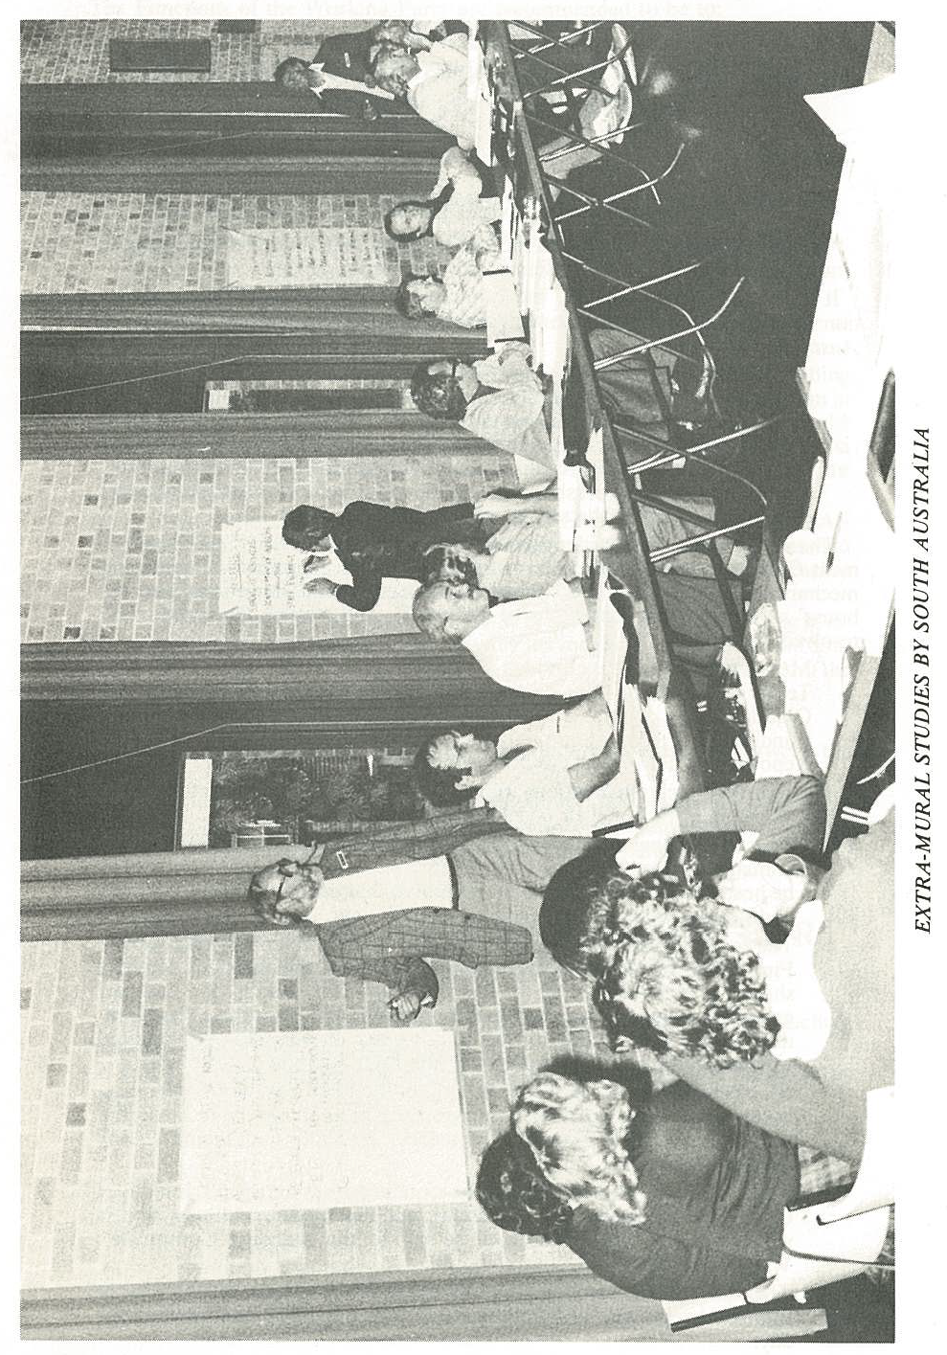
Notes:
Pick yours truly!

Slide 14
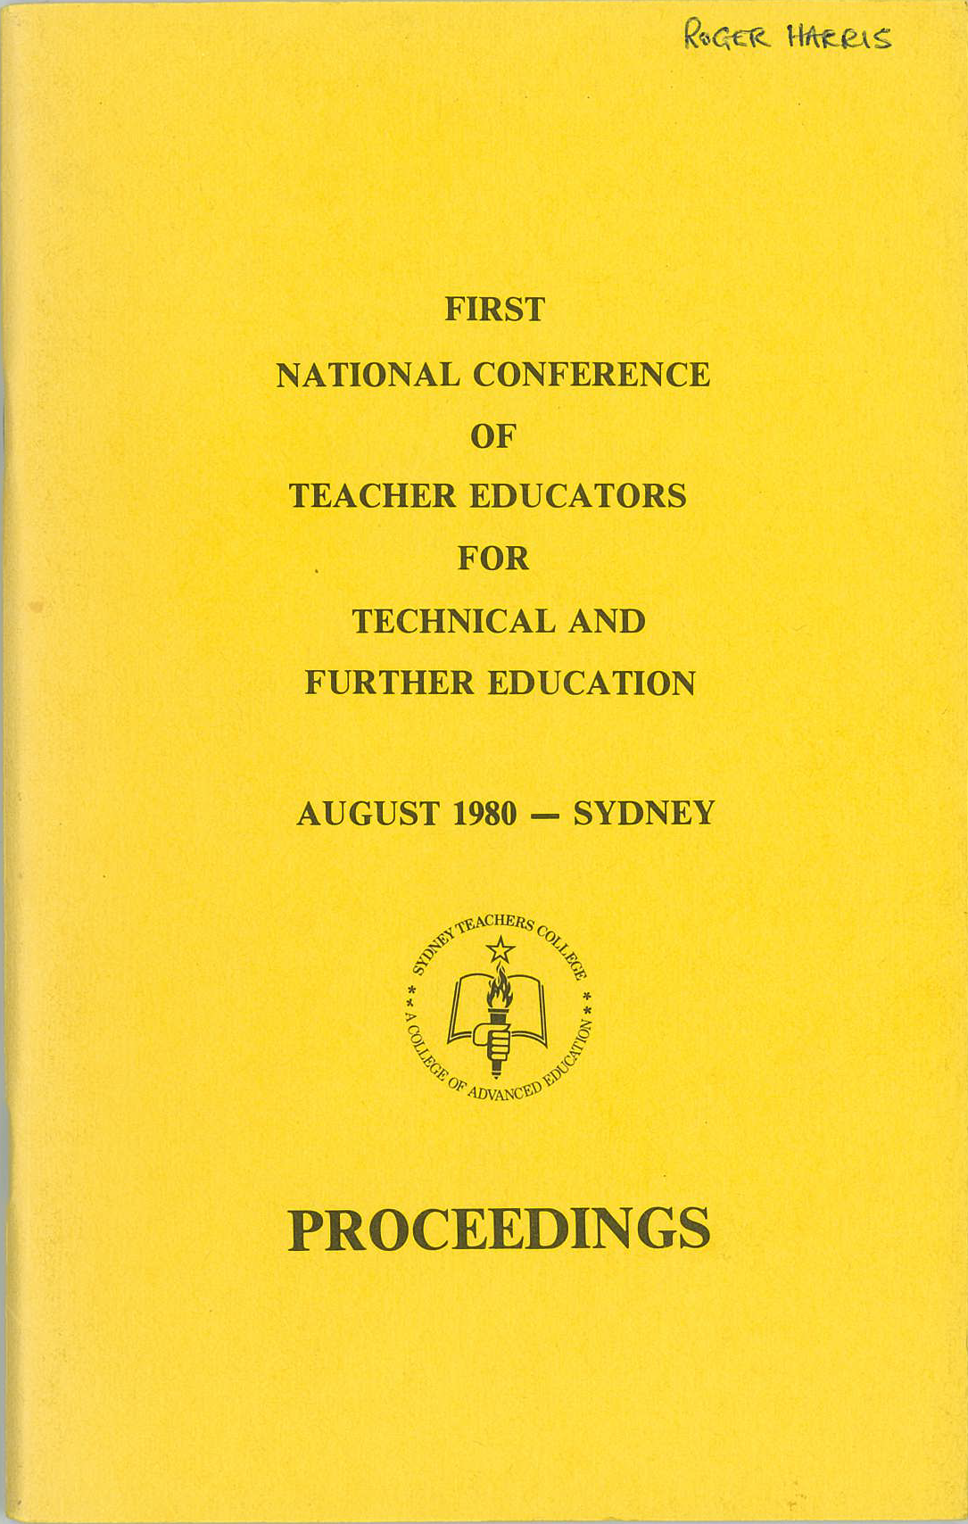
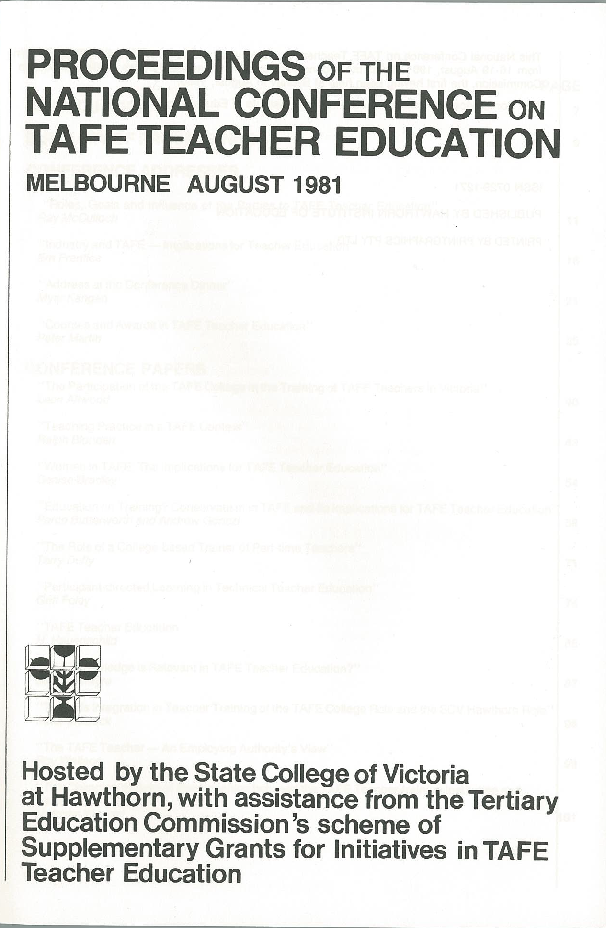
Notes:
Covers of the 1st and 2nd Conferences

Slide 15
National Conferences on TAFE Teacher Education
National conferences of those (a wide representation) with interests in VET teacher preparation followed up Fleming recommendations
1st: University of Sydney, 10-13 August 1980 (N=62)
2nd: SCV at Hawthorn, 16-19 August 1981 (N=75)
Strongly backed a 3-year qualification (UG2) as a minimum, for 2 years FT T/E by in-service training (Rec 3)
UG2: ‘as only awards at this level will enhance the professional status of TAFE teachers’ (Rec 4)
Programs be primarily concerned with adult teaching and learning (Rec 6)
In accreditation, ‘the significance and legitimacy of the in-service mode must be recognised’ (Rec 7)
Notes:
Vigorous debate over level of qual. continued in these forums.
Rec 3: That TAFE teachers completing initial TE programs be granted a UG2 (Dip.) award as a minimum, for two years FT TE by in-service training. Compared with the UG3 (Assoc. Dip.), a broader field of knowledge’, “will proceed to greater depth in individual units”, structured with major and minor studies to be treated in some depth, expected that broader reading will be required, and more demanding methods of assessment.
Rec 8: no technical studies

Slide 16
At the 1st Conference (1980)
Peter Brereton (Ass. Principal, Hawthorn) referred to “the untidy and unseemly milling around with UG3s and UG2s” (p.37)
In his Address, Joe MacRory (Newcastle CAE) colourfully made the following points:
- To imply that the training could ever be regarded as a ‘relatively
restricted area of knowledge or consisting of developing skills in
limited fields’ is, to say the least, absurd. A UG3 is a counterfeit
award.”
- “TAFE teachers must walk through the front door of tertiary
institutions rather than the tradesmen’s entrance in seeking a
professional award. [We must} outlaw our persistent backdoor
approach to the case for a UG2 award and recognise TAFE teachers as
legitimately entitled to it as professionals.”
- “A UG3, apart from being inappropriate, demeans the professional
status of TAFE teachers and is therefore counterfeit.”
Notes:
Peter Brereton (Ass Principal, Hawthorn SCV) at the 1st Conference called it “the untidy and unseemly milling around with UG3s and UG2s” (p.37)
One participant (Joe MacRory, Newcastle CAE) colourfully claimed in his Address at the same Conference:
“The UG3 [ass dip] is distinguished by its relative specificity … To imply that the training could ever be regarded as a ‘relatively restricted area of knowledge or consisting of developing skills in limited fields’ is, to say the least, absurd. A UG3 is a counterfeit award.” (p.23)
Concluded that the creation of a professional award … can only be at the UG2 level” (p.31)
“TAFE teachers must walk through the front door of tertiary institutions rather than the tradesmen’s entrance in seeking a professional award. [We must} outlaw our persistent backdoor approach to the case for a UG2 award and recognise TAFE teachers as legitimately entitled to it as professionals.” (p.34)
“A UG3, apart from being inappropriate, demeans the professional status of TAFE teachers and is therefore counterfeit.” (p.31)

Slide 17
At the 2nd Conference (1981)
Even broader representation (N = 75), esp. TAFE principals
4 conference addresses; 11 conference papers; 11 workshops
Focus not on resolutions – but rather, investigation of issues
One issue –separate course for graduates and non-graduates? ‘Wide range of opinion’; ‘extraordinary diversity’
Another issue – what shd. be the minimum level of award to gain profl. recognition as a TAFE teacher? ‘One of few questions where there was really strong agreement’; ‘Overwhelming majority voted for the UG2 award’
Reaffirmed the resolutions of the 1980 conference
Kangan gave the Dinner Address:
- pleased to see: enrolment ‘revolution’; ‘dramatic’ increase in funds
to TAFE; these national gatherings (‘develop reciprocal confidence’)
- Plea: ‘Please discourage politicians from turning the clock back’!
[on the TAFE image]
Notes:
Kangan gave the Dinner Address: he was pleased to see:
(a) enrolment increases (he called this a ‘revolution’ – ‘unheard of in the history of education, of adult education in particular, that within a period of 7 to 8 years enrolments would have more than doubled.’),
(b) increased funds to TAFE (altered in such a dramatic way – back in 1974, TAFE getting 20% of all funds going to post-secondary education, now must be approaching 33% of total spending), and
(c) these national gatherings (they develop reciprocal confidence in one another…)
Acronym TAFE was an accident – he deliberately avoided ‘technical education’ in his report title because of its ‘low-dive’ image. He sees the ‘image has changed’ – ‘self-esteem has risen’. [But not now!]
He stated (Note: 1981) that ‘TAFE is now in danger of treading it [image] back! [How true!]
He concluded: ‘Please discourage politicians from turning the clock back’!!!
There were other National Workshops on TAFE T/E: 1st in 1991; 2nd in Adelaide Oct. 1992
Second one: Desire to discuss implications of the many reports – especially Predl and Carmichael Reports
TAFE teachers and trainers will ‘have to be more educated and trained’ (Brinkworth, Hawthorn SCV)
Reiteration of need for cooperation between TAFE and universities
Improved networks for sharing learning materials / resources
Bach. Teach. should be minimum qual. to teach - for permanency

Slide 18
Other studies!
NCVER (1990). National review of TAFE teacher preparation and development
VEETAC (1992). Staffing TAFE for the 21st century (Predl Report)
Blunden, R. (1997). Teaching and learning in VET (book)
Dickie et al. (2004). Enhancing the capability of VET professionals (ANTA)
Mitchell & Ward (2010). The JMA analytics model of VET capability development
Skills Australia (2010). Australian workforce futures: A national workforce development strategy
Guthrie (2010). Professional development in the vocational education and training workforce; and other papers 2010-11
IBSA (2011). Pathways for VET educators: Higher level VET ed. quals. & f/w
Wheelahan & Moodie (2011) .The quality of teaching in VET
AWPA (2013). Future focus: National workforce development strategy
Guthrie & Every (2013). VET teacher, trainer and assessor capabilities, qualifications and development
Brennan Kemmis & Atkins (2014). Teaching in the VET sector in Australia (book)

Slide 19
PD for VET teachers?
Fleming’s day: the Staff Development Advisory Committee of the TAFE Council in the Tertiary Education Commission
National Staff Development Committee (NSDC) - established under ANTA to promote and fund staff development throughout VET - disbanded 1996
ANTA then went to its Framing the Future (later RtF) to explain and facilitate the introduction of the new National Training Framework - started 1997, ended 2008
Little left now - with the notable exception of the VET Development Centre in Victoria, began 2005 (as the TAFE Development Centre) to reinvigorate the Victorian TAFE system through provision of best practice professional development opportunities
PC Report (2011): concluded there is need for further PD (beyond Cert IV) but such opportunities are inadequate
Notes:
FtF/RtF statistics 1997-2008:
number of projects, 1997-2008 2298
estimated participants, 1997-2008 * 65673
main participant groups, 1997-2008 TAFE 54%, Private RTO 19%, ISB 9%
PC (2011) concluded that, while the Cert IV is adequate for initial preparation, there is need for further PD, BUT that such opportunities are inadequate. Been the story all along!

Slide 20
Economy/market influences?
General: dissatisfaction with some of the university offerings in TAFE T/E
‘re-discovery’ of the workplace as a site for learning
Universities climbing league tables to attract customers – VET status low
Competition - all organisations reducing costs in name of ‘efficiency’
Market, fuelled by technology, encourages ‘short-termism’ – quick fixes
Need for an educated, flexible workforce – many people in training roles – expansion of ‘VET workforce’ – minimum qualification sought
Market raises status of disciplines like business and IT – a concomitant decrease in the value attached to VET teaching
Need for flexibility in employment arrangements in name of agility – increasing casualisation – variable quality
‘Secular stagnation’ in advanced economies – many argue insufficient investment in education and training (and infrastructure)
Fundamentally, supply and demand – numbers of consumers decreasing, causing HE programs to be closed down
Notes:
See separate pages.

Slide 21
Fallacy of misplaced concreteness?
Are we witnessing what Alfred Whitehead termed ‘the fallacy of misplaced concreteness’?
= the mistaken inclination to treat abstractions [e.g. the market as living entities capable of volition and of defining problems and solving them; mistaking a theoretical construct for a physical reality
‘The market’: abstract construct depicting the reality of exchange of goods and services. Encourages forces of demand and supply to operate, where buyers and sellers trade goods, services, or contracts or instruments, for money or barter. Consumers patronise what they want. However, the market has been unable to stem or reverse inequality that economic growth sometimes causes (Maskin)
Prof. Eric Maskin (Nobel laureate in economics) has stated:
- ‘the market is no God – it cannot solve every problem’
- yet ‘most policy-makers embrace a religious-like belief
that the market can and should solve every problem’
Notes:
People tend to mistake abstract concepts for accurate descriptions of reality.
The danger? the “fallacy” [like the market] can cause an unrealistic infatuation with Utopian ideals that end up disappointing everyone and generating cynicism.

Slide 22
5. Concluding thoughts
‘Not proved easy … no simple solutions’ (Hermann et al. 1972)
Goals from earlier years (e.g. parity of esteem, enhanced status, deep understanding, more data) not been attained, and situation is worsening (cf. Hetherington & Rust 2013)
Ironic that this is happening just as:
(a) teacher preparation in other educational sectors
(b) VET teacher preparation in other countries is
being critically examined and enhanced!
Tightrope? – yes, and the market has played its part
Quality of VET system depends heavily on quality of those who deliver/assess it
While VET teacher / trainer preparation and PD are not adequate (declining?), quality of VET continues to be an ongoing, serious concern requiring urgent attention
Notes:
Key theme: “Providing a T/E course for teachers of trade and technician courses that will produce competent practitioners as well as producing teachers with a broad outlook has not proved easy, nor are there likely to be simple solutions to the problems that such courses raise.” (Hermann et al. 1972) – debates in late 70s and early 80s, still in eqarly 90s, iterations of Cert IV, rise and fall of PD scheems
Per Capita report (Hetherington & Rust, 2013): Objectives of competition/contestability were to:
- increase the supply of qualified trainees
- attract greater private investment
- improve quality through competition.
Their conclusion from the Victorian experience - succeeded in one of its primary goals: dramatically lifting the supply of new trainees.
However, there have been unexpected and damaging consequences elsewhere:
- The ‘uncapping’ of the market has led to a bubble which has resulted in a $300 m p.a. blow-out in public spending on VET – common in sectors where public funds are newly made available to private providers (e.g. employment services and household solar energy systems!)
- New entrants offer variable quality. In VET, employer groups report falling confidence in the quality of skills delivered by the training system.
Other teachers: teacher education for school-teachers being continually reviewed, national standards introduced, and higher qualifications demanded
Internationally: significant commitment and enthusiasm in the EU for improving VET the status of teachers, e.g. Germany (Marius)
Tightrope? Heyday in my view occurred through the 1980s and early 1990s

Slide 23

An apt ending
Greg Woodburne’s concluding comment at the 1st National TAFE Teacher Education Conference in 1980 (35 years ago!):
TAFE [VET] teacher education on the whole has moved a
long way from being a blurred carbon copy of primary and
secondary teacher education; however, it still has a long
way to go to demonstrate that what it has managed to create
reflects in real terms the needs of the unique combination
of students and courses that the TAFE [VET] teacher
is asked to serve. (p. 65)
What do you think?

