Slide 1
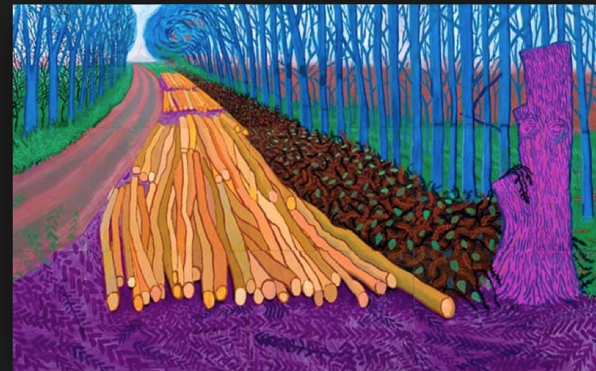

Re-interpretations:
Researchers present new ways of looking at their research
Erica Smith, Stephen Billett, Sue Webb, Llandis Barratt-Pugh

Slide 2

Research on an IPad
‘Big Pictures of VET Research’
We present….
Inspired by the current David Hockney exhibition

Slide 3

D
Each Researcher presents:
One IPad ‘Big Picture’ slide –
Reconceptualising a body of
research work.
One IPad slide listing the key points.
One IPad slide listing the relevant research studies.

Slide 4

D
What’s right and what’s wrong with competency-based training? Erica
The standing of vocational education: Status, consequences and responses. Stephen
Where is the education in vocational education and training? Sue
Managing learning: Critical practices for orchestrating and producing learning in organisations. Llandis

Slide 5


Just as Fine Art has progressed from oils to etchings, performances and video.
So David Hockney has continually adopted technologies in his work:
He began by capturing technology invading nature with his pictures of Californian sprinklers and pool reflections.

Slide 6
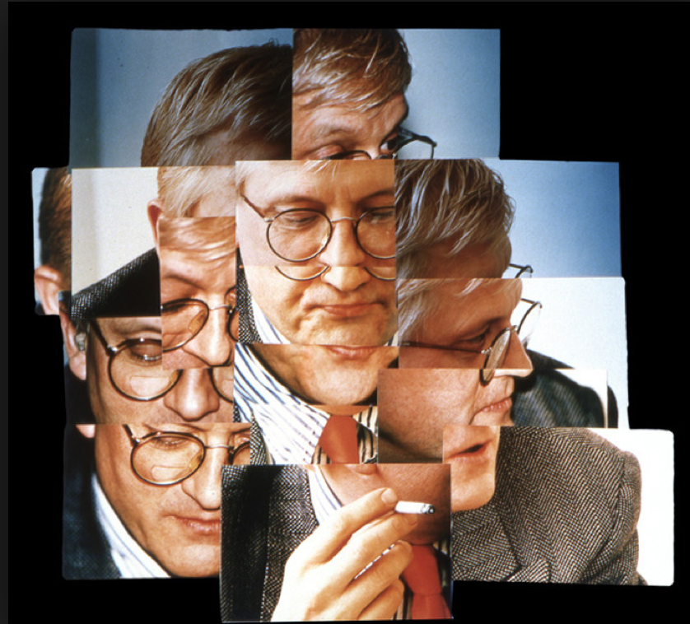

He used compact 35mm auto-lens cameras for his ‘Joiners.
And now he is using Photoshop and IPad painting programmes.
For the first time in art history, every reproduction is now the same as the original.

Slide 7
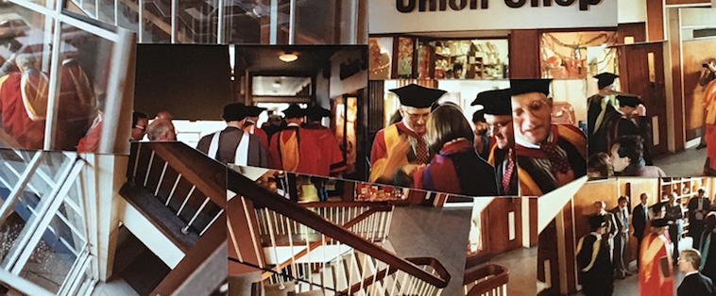
In 1983 David Hockney received an Honorary Doctorate from the University of Bradford – Llandis took a ‘joiner’ of this event.

Slide 8
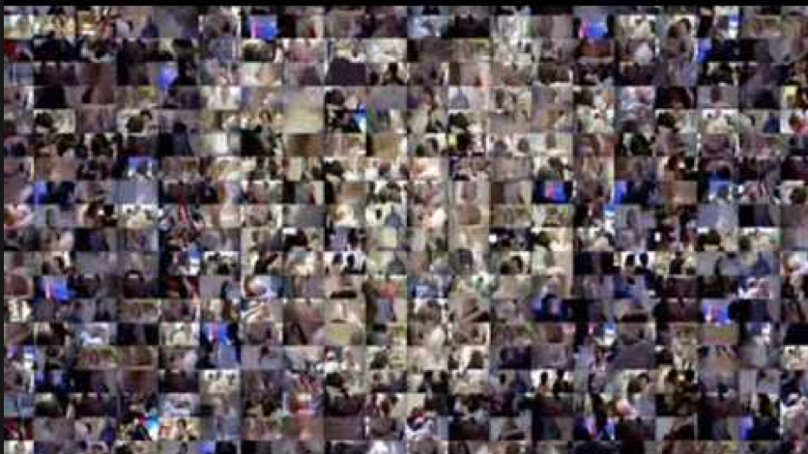
But now - complete libraries now lie on your Kindle.
Your whole academic life work is on a USB
A year of your life in pictures now flashes on your phone screen….
We now reinterpret and refocus our work - onto a small screen.
In reflection – what have we learned and what does it all mean?

Slide 9
CBT: an image. CBT in 1994
S: Based on competency standards or with formal industry consultation; C: Written in CBT format
I: Industry Involved in course monitoring; R: RPL procedures operated; A: Assessment on demand and at least partly in the workplace

Slide 10
My publications specifically about CBT
Smith, E., Smith, A., Hampson, I. & Junor, A. (2015). How closely do Australian Training Package qualifications reflect the skills in occupations? An empirical investigation of seven qualifications. International Journal of Training Research, 13;1, 49-63.
Smith, E. (2010). A review of twenty years of competency-based training in the Australian vocational education and training system. International Journal of Training and Development, 14:1, 54-64
Smith, E. (2008). Curriculum and assessment in vocational education and training. In J. Athanasou (ed). Adult Education & Training. Terrigal, NSW: David Barlow Publishing, 251-266.
Smith, E. & Keating, J. (2003). From training reform to Training Packages. Tuggerah Lakes, NSW: Social Science Press.
Smith, E. (2002). Training Packages: Debates around a new curriculum system, Issues in Educational Research, 12:1, 64-84.
Smith, E. (1999). How competency-based training has changed the role of teachers in the VET sector in Australia. Asia Pacific Journal of Teacher Education, 27:1, 61-75.
Smith, E. (1999). Ten years of competency-based training: the experience of accredited training providers in Australia. International Journal of Training and Development, 3:2, 106-117.
Lowrie, T., Smith, E. & Hill, D. (1999) Competency based training: A staff development perspective. Adelaide: NCVER.
Smith, E., Lowrie, T., Hill, D., Bush, A., & Lobegeier, J. (1997). Making a difference? How competency-based training has changed teaching and learning (ANTARAC research project). Wagga Wagga: Charles Sturt University.
Smith, E., Hill, D., Smith, A., Perry, P., Roberts, P., & Bush, A. (1996). The availability of competency-based training in TAFE and non-TAFE settings in 1994. Canberra: AGPS.

Slide 11
An evolving see-saw
Right
Industry involvement and interest
Transparent
learning outcomes
Wrong
Teachers find it almost impossible to implement
‘Knowledge’ sits uneasily
Expanded to all vocational areas equally
Assessment has superseded learning
No mandated hours of learning: Open to abuse
Harris & Hodge (2009): ‘A propensity to polarise’
West (2004):
Technical, moral and market critiques.
Smith & Keating (2003): Philosophical, educational and practical objections.
Edwards (2017): ‘Out of steam’ critiques

Slide 12

The standing of vocational education: Status, consequences and responses

Slide 13
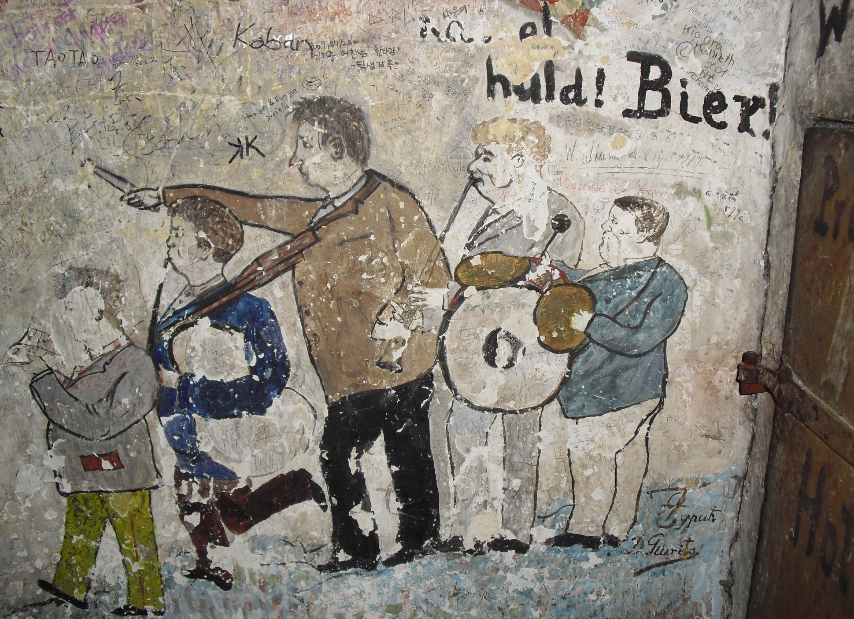
Status
Relatively low status
Status of occupations and education provisions – a societal sentiment, promoted by elites (aristocrats, theocrats, bureaucrats), not those who practice
Equivalence argument lost
But quite distinct valuing of occupations/skilfulness across time, communities and place
Billett, S (2017 in press) Vocational Education and the Individual, in Unwin, L. & Guile, D. (eds) Handbook of Vocational Education and Training, Wiley, United Kingdom (accepted 28th July 2016)
Billett, S (2014) The standing of vocational education: Sources of its societal esteem and implications for its enactment. Journal of Vocational Education and Training, 66 (1) 1-21
Billett, S (2012) Vocational education and training, culture and self: Dominant interests, diverse traditions and globalised time, in S. Stolz & P. Gonon (ed) Challenges and Reforms in Vocational Education
Billett, S. (2011) Vocational Education: Purposes, traditions and prospects, Springer; Dordrecht, The Netherlands ISBN 978-94-007-1953-8

Slide 14
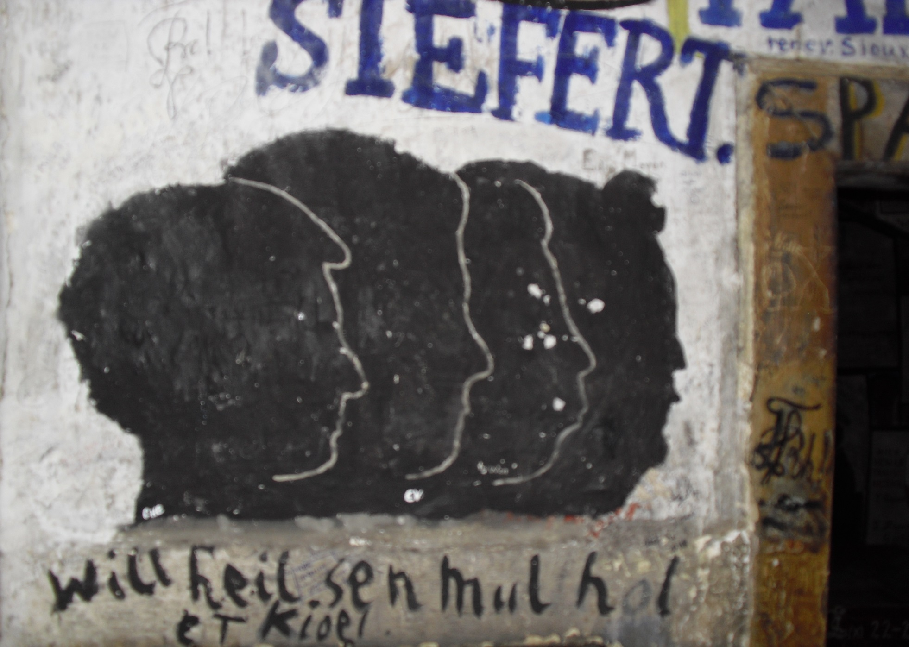

Consequences (economic and social)
Skill shortages, Shortage of highly skilled technical workers
Short tenure as skilled workers – progression to managerial roles
Last resort occupations
Low completion rates
Shape how society views and supports VET and the occupation is serves
Influences how individuals participate, parents advise about and employers’ willingness to engage with and support vocational education
Kinds of educational purposes and processes, including their duration
Responses
Championing the nature and value of skilled work
Not uniform or without complexity
Enhancing the status and standing of the occupations served by VET
Local engagement and commitment

Slide 15

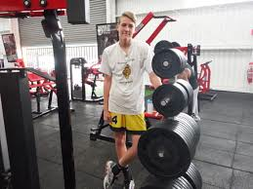



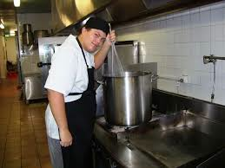
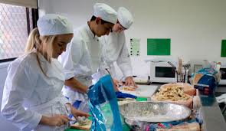

Where is education in VET in Australia?

Slide 16
The VET messages:
Intrinsic value – what are people learning – images show lots of happy people looking at objects and activities – not focused on intrinsic educational role of VET, i.e. how and what people learn;
Instrumental value – images highlight the objects/activities that ‘belong’ or ‘go with’ certain types of people, the people are ‘doing’ the vocation –this is what VET can offer people who look like this;
Positional value – images indicate the position and skills that vocational learning leads to, signalled by dress codes, types of people, locations of images and the things people can manipulate/operate.

Slide 17



What epistemic access is VET providing?
Australian report on students by industry above and Bridges to Higher Education to the right
UK further education

Slide 18










Managing Learning
Ten Critical Practices for Orchestrating and Producing Learning in Organisations

Slide 19
Managing Learning
Gain Support from the Powerful
Walk the Job and Sense Issues
Generate Vision with Champions
Agree Clear Goals
Give Everyone a Development Agenda
Negotiate with Gatekeepers
Give Learners Ownership
Let Learners choose Pathways
Evaluate Progress
Monitor Individual Health

Slide 20
Research Studies
Management Information System for NFP organisations – CI UK – 1979/82
Integrated Employee Development – CI UK – 1982/85
Teacher Assistant Development Programme – CI UK – 19 87/89
CBT Workplace Learning – NCVER – 1998/2000
TAFE Leadership – NCVER – 2002/3
Frontline Management Development – NCVER – 2001/5
Department of Planning and Infrastructure culture change – 2004/7
Professional Wellbeing – ARC – 2005/9
Mandatory Construction Training – CTF WA – 20010/13
Building Research Capacity – NCVER – 2010/15
Improving Supervisor Development – ATL – 2012/15

Slide 21
Contact the researchers
Erica Smith (Federation University) e.smith@federation.edu.au
Stephen Billett (Griffith University) s.billett@griffith.edu.au
Sue Webb (Monash University) susan.webb@monash.edu
Llandis Barratt-Pugh (Edith Cowan University) l.barratt_pugh@ecu.edu.au

